Slide 1
An Archaeological Guide for Android devices
The Ostia Antica Park is one of the largest and most important archaeological sites of ancient Rome. With its fifty hectares, its buildings and its streets, it testifies the development of a large urban and commercial center during the imperial age. Ostia was the most important port of the antiquity, the gate of Rome on the Mediterranean sea.
This document describes the development of an archeological guide for Android devices.
At the time of the writing these Apps are the only digital guides of Ostia Antica for Android devices.

Slide 2
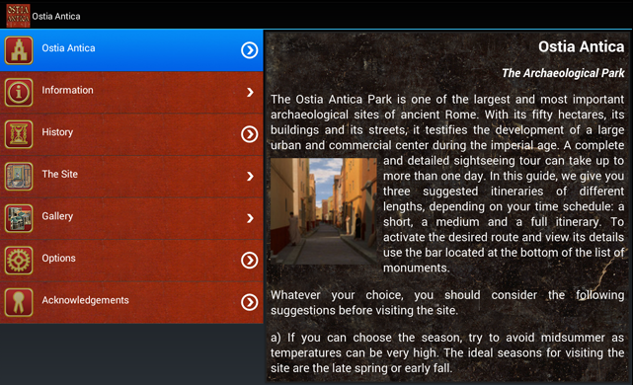
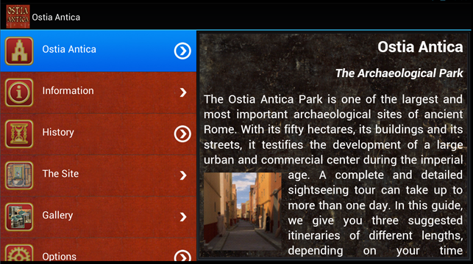
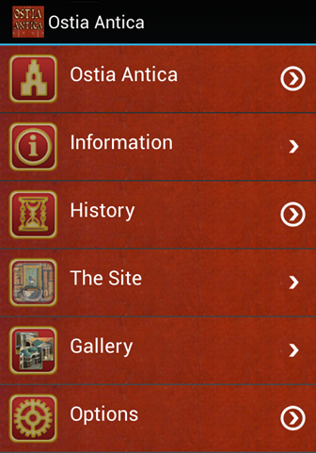
An Archaeological Guide for Android devices
The main menu of the app for Android smartphone and tablets

Slide 3
Specifications
3 Languages: english, french and italian selectable within the App
4 layouts with different color scheme selectable withing the App
Listview architecture for small smartphone
Master detail architecture for large smartphone and tablets
Unified application for Android marketplace
Content in HTML
Picture Gallery
Suggestion of three different itineraries
Monuments geolocalization
Custom Artwork
Zoom full screen for images
Rotation support

Slide 4
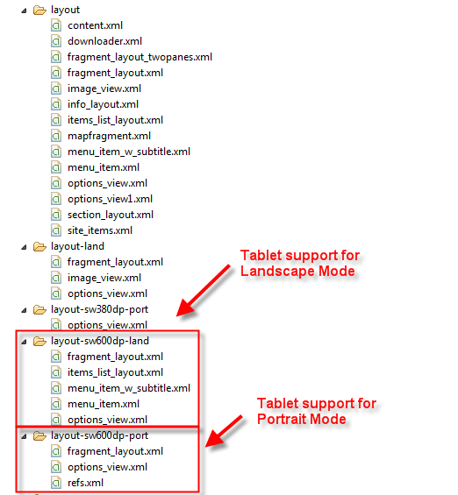
Application Architecture
The app uses a unified interface that adapts to screen resolution. This has been implemented using Android Configuration Qualifiers

Slide 5
Application Architecture for Tablets
For large Smartphones or Tablet the application uses the Landscape mode in Master/Detail configuration. On the left side of the screen a Listview displays the items, while the detail of the selected item is displayed on the Right side of the screen.

Slide 6
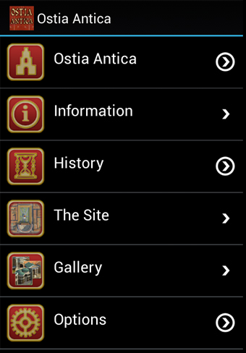
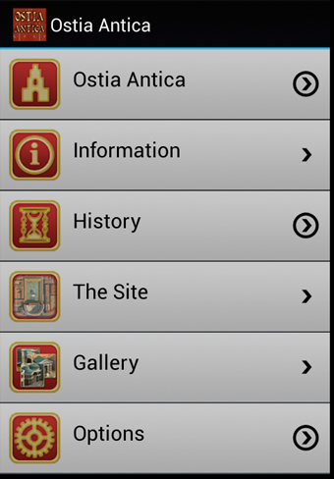
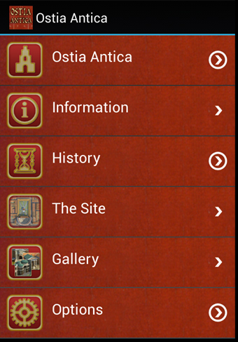

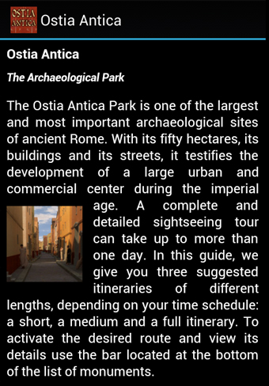
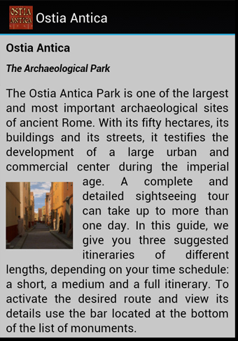
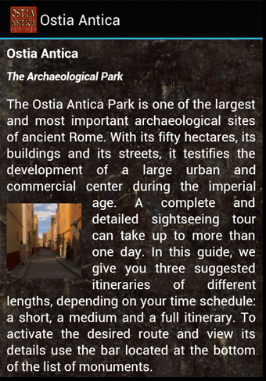
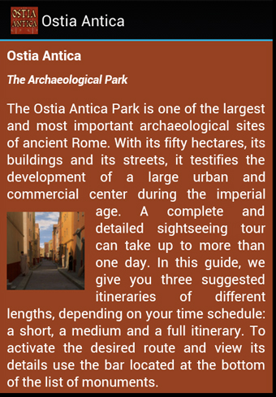
Layouts
The application offers 4 different layouts for a optimal contrast in darkness or strong lightning. The layouts can be switched directly from the interface.
Black Elegance
Modern Touch
Pompei Style
Roman Era

Slide 7
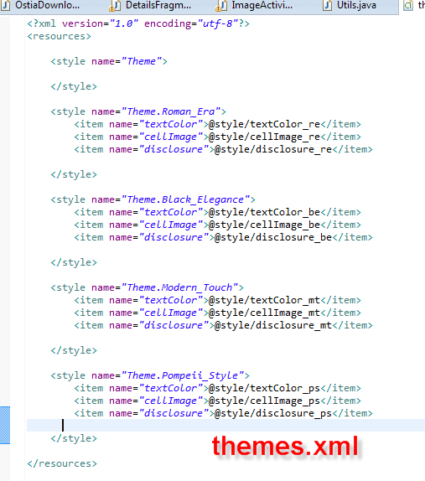
Layout Implementation
Layout have been implemented using the Android Theme functionality. The Theme allows developers to customize any elements of the interface and even to change the Theme runtime. The theme definition is stored in the file theme.xml located in the values folder.
Each theme define, for a given property name (e.g. textColor) a different value stored in the styles.xml file. So, if the Theme.Black_Elegance is selected, the textColor point to the value defined in textColor_be stored in the file styles.xml

Slide 8
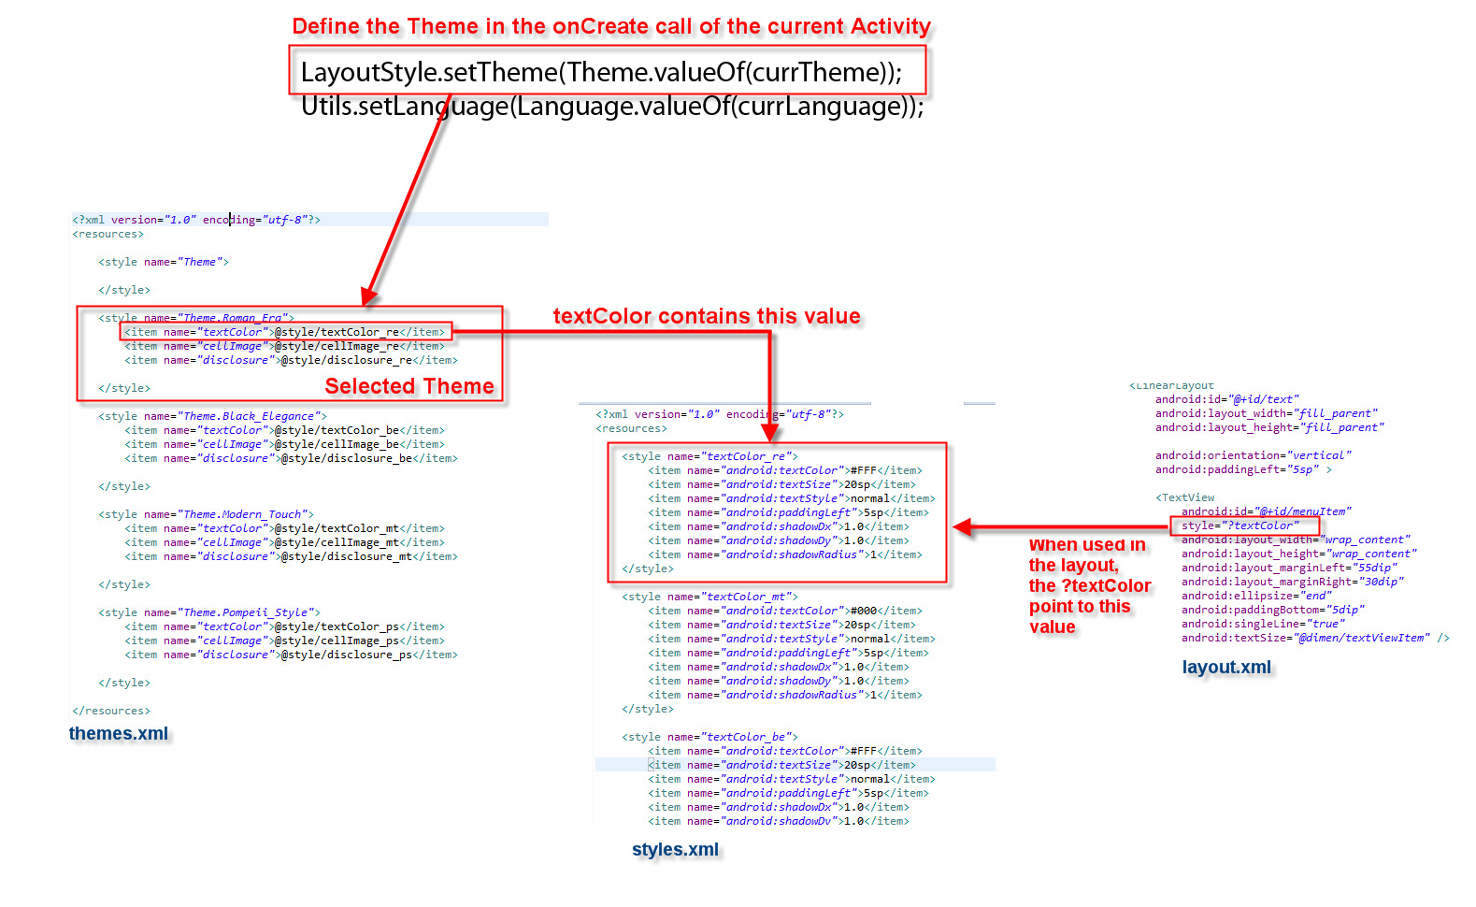
Layout Implementation

Slide 9
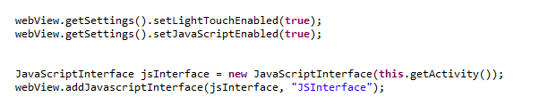
Custom HTML Tags
The app uses standard HTML to display content. Nevertheless, we want to intercept the click event to allow zooming images in a different Activity. This can be done by enabling the JavaScript execution for the webview.
The jsInterface is an instance of JavaScriptInterface, a custom class that can be used to define the methods that can be called via javascript.

Slide 10
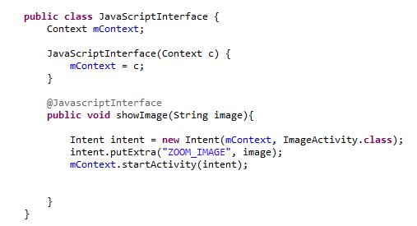
Custom HTML Tags
In this class we find the method showImage that take a String argument as parameter.

Slide 11
Custom HTML Tags
In the HTML we can now define a Javascript function as follow. When the webview encountrer a javascript call to JSIntefacte, Android will dispatch the request to the Java method showImage of the class JavaScriptInterface.
<script type="text/javascript">
function showImage(image) {
JSInterface.showImage(image);
}
</script>

Slide 12
Custom Image Tag
This snipplet displays a img tag using a call to the Javascript linked to the class JavaScriptInterface. This tag display an image in the HTML code. When the user click on the image, the event is intercepted by the Javascript function showImage that in turn calls JSInterface.showImage(image), passing the control to the java method showImage(String image) in the class JavaScriptInterface.
<img align='right' onClick="showImage(‘overview_from_necropolis_h.jpg')" class='imgright' src=‘overview_from_necropolis_l.jpg'/>

Slide 13
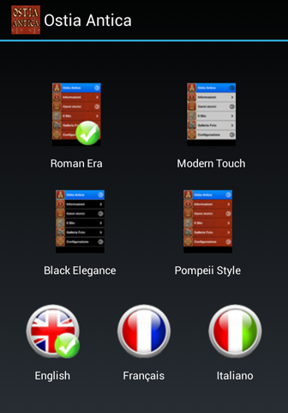
Languages
The application offers the possibility to switch instantly between English, French and Italian. The language switching impacts the contents as well every element of the application interface.

Slide 14
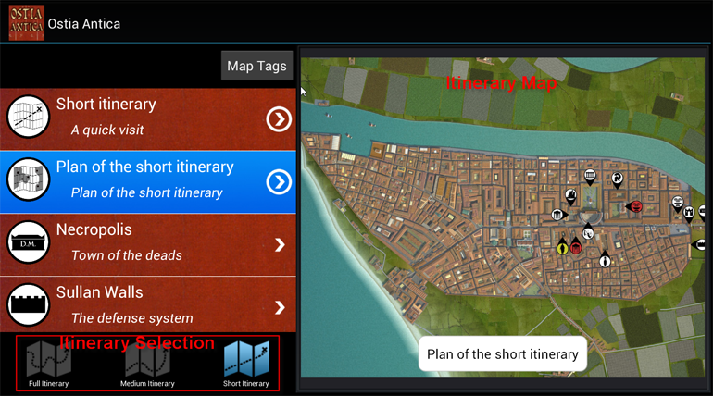
Itineraries
The TabBar at the botton of the Site Listview can be used to switch between three suggested itineraries. The first item of the list describes the itinerary, while the second item will show a map with the monuments that you select. It is possible to zoom the map for a better viewing.

Slide 15
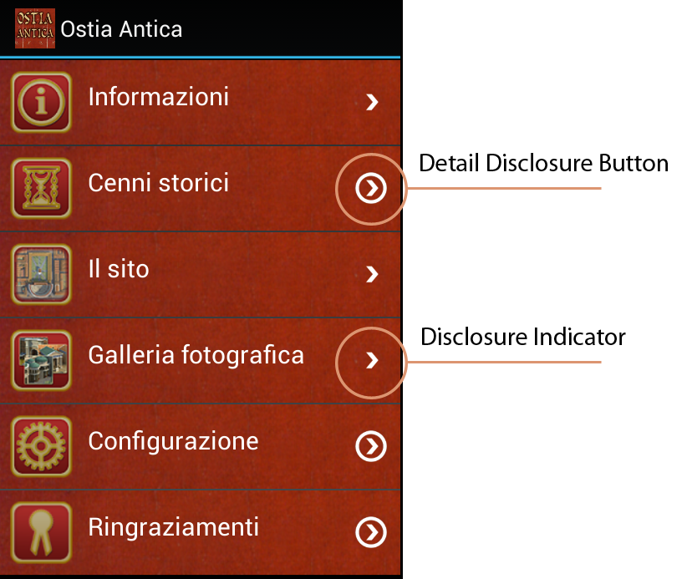
Navigation
Disclosure indicator. When this element is present, users know they can tap anywhere in the row to see the next level in the hierarchy or the choices associated with the list item.
Detail disclosure button. Users tap this element to see detailed information about the list item.

Slide 16
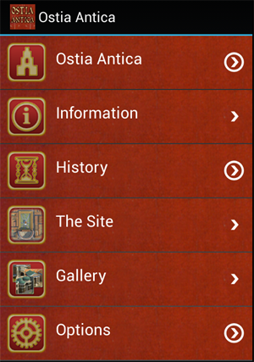
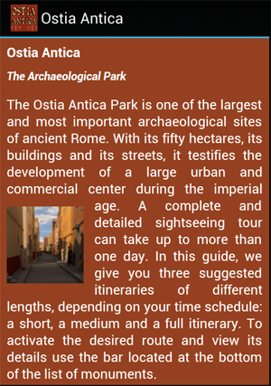
Menu Ostia Antica
It describes the Archaeological Park of Ostia Antica, the ancient harbour of Rome

Slide 17
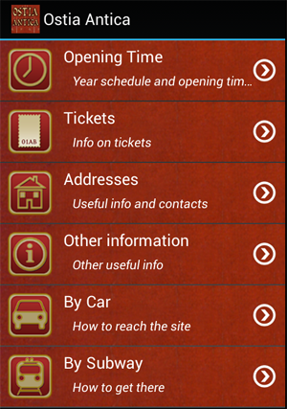
Menu Information
It gives access a submenu with useful information about the Archaeological Park

Slide 18
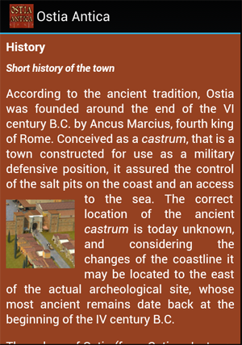
Menu History
It describes the history of Ostia, from the origins till IX century A.D.

Slide 19
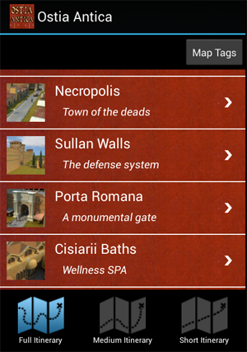
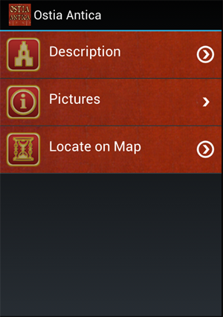
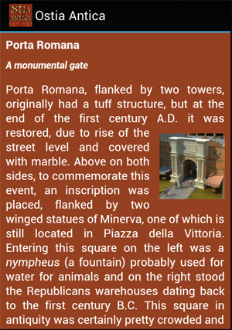
Menu ‘The Site’
It gives access to the description and images of the monuments of the site. It can be used also to select the monument based on the 3 itineraries. Each monument has 3 submenus to display text, images and geographic location.

Slide 20
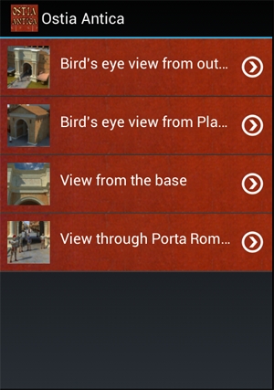
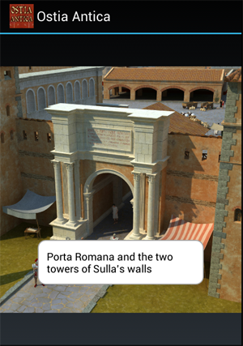
Menu ‘The Site’
The view Pictures lists all the Computer Graphics Reconstruction of the monument.

Slide 21
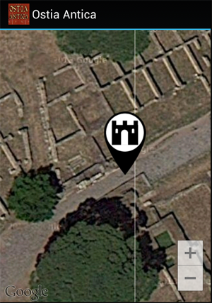
Menu ‘The Site’
Google Map is used to display the geographic location of the monument of interest.

Slide 22
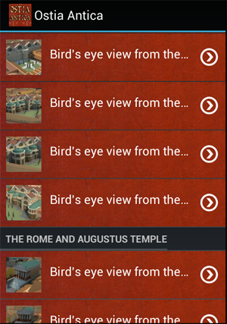
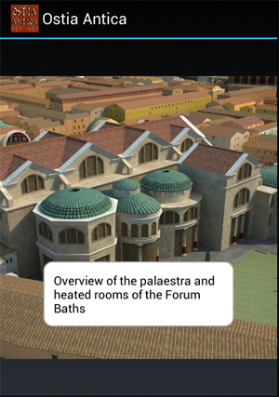
Menu Gallery
This view offers a categorized list of all Computer Graphic Reconstructions of the town of Ostia

Slide 23
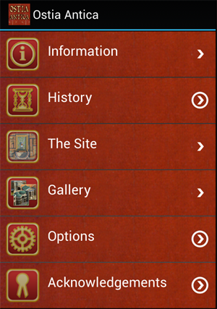
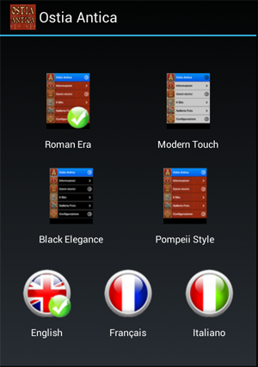
Menu Options
It is used to select the layout type and the language of the application.

Slide 24
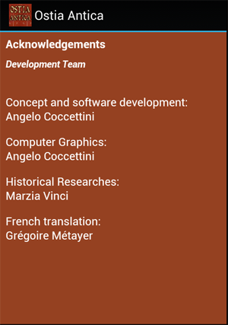
Menu Acknowledgements
Display info on the team that has worked for this version of the application

Slide 25
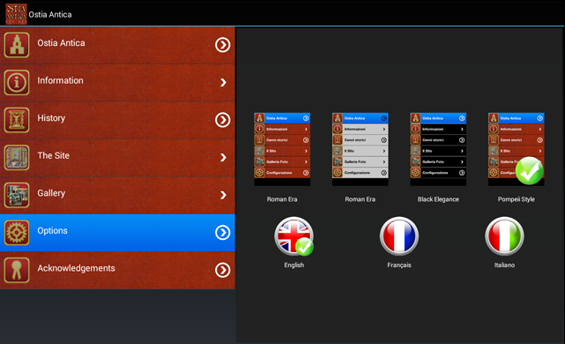
Options
The language selection is indipendent from the device settings. It is possible to switch between English, French and Italian at runtime. The content and the interface switch instantly.

Slide 26
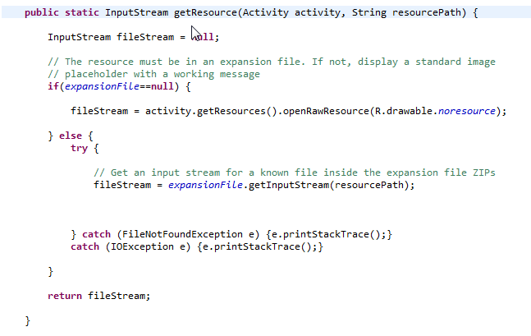
Expansion Files
The size of an application for Google Play is 50 MB. After that limits an application must use Extension Packages to store artwork and resources. Ostia Antica uses one Expansion Package to store the high resolution version of all images. HTML and low resolution images are stored in the asset folder.

Slide 27
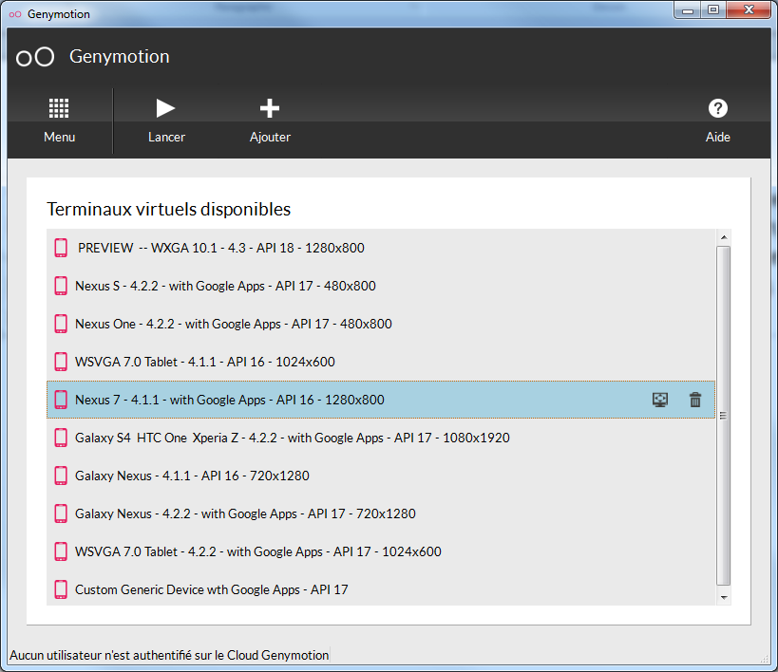
Virtual Devices
The virtual devices installed with the SDK are too slow. Even when they use the hardware accelerator , they are quite slow and difficult to manage. In addition, on these virtual devices, it is not possible to use the Google services hence the Mapview is not working. In orde to debug Google Maps on virtual devices it is possible to use Genymotion suite that implements fully functional virtual devices based on Oracle VM Virtualbox.
http://www.genymotion.com/

Slide 28










Artwork
I have produces all the Artwork of the application. Here some example of artwork for both applications.
Map tags
Map Pins

Slide 29















Artwork
Interface

Slide 30
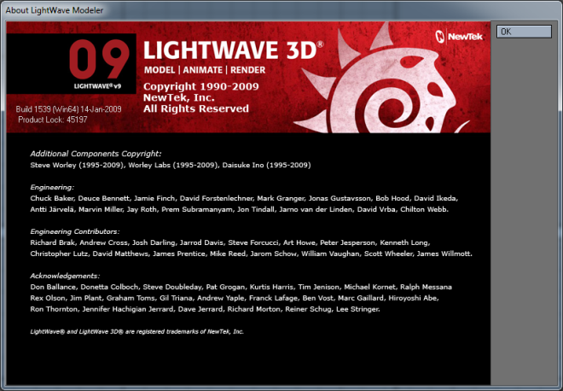
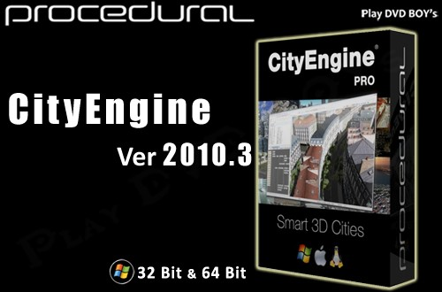
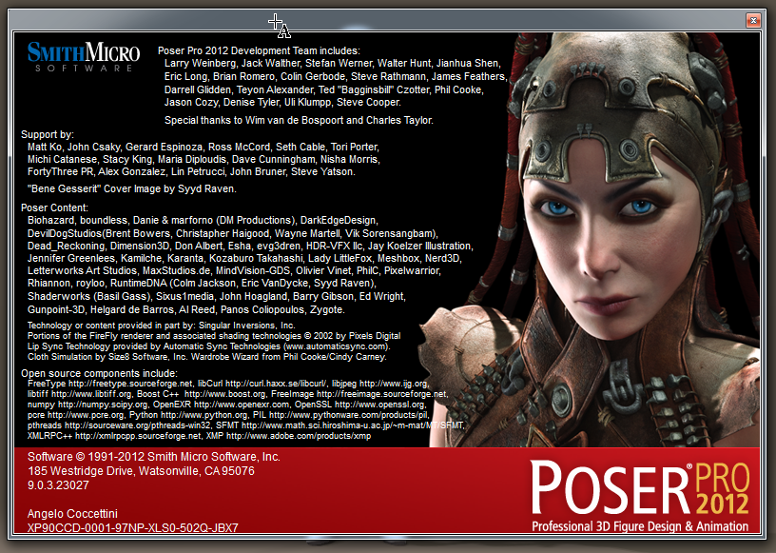
Computer Reconstructions
I have reconstructed the whole town with Computer Graphics software:
LightWave from Newtek
CityEngine from ESRI
Poser from SmithMicro

Slide 31
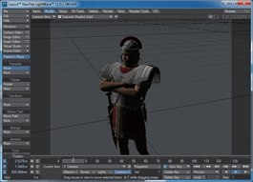
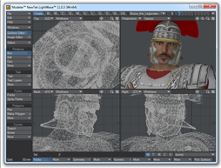
Workflow
Layout
Modeler
HUB
PoserFusion
Export Wavefront
OBJ, MTL

Slide 32
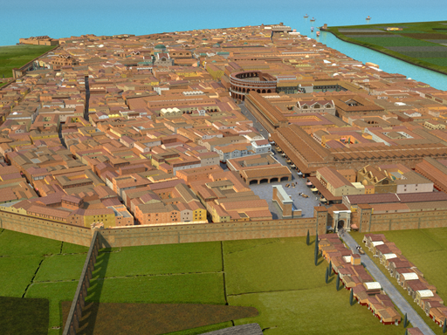
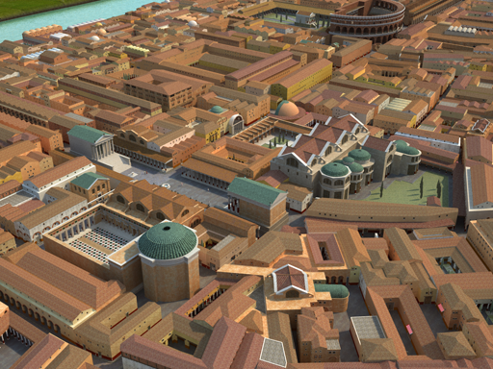
Reconstructions
I have modeled the whole town with a uniform level of details. This mean that it is possible to move the digital camera in any place and to produce high detailed images. The polygon count of the whole scene (building, actors, props and stage) is around 15.000.000 of polygons.

Slide 33


Google Play
The Apps are published and available on Google Play
https://play.google.com/store/apps/details?id=com.betasoft.ostia.main&hl=en
angelo.coccettini@gmail.com

