Slide 1
An Archaeological Guide for iOS devices
The Ostia Antica Park is one of the largest and most important archaeological sites of ancient Rome. With its fifty hectares, its buildings and its streets, it testifies the development of a large urban and commercial center during the imperial age. Ostia was the most important port of the antiquity, the gate of Rome on the Mediterranean sea.
The most frequent question I had during my several visits of this amazing archaeological site while observing a ruin or a monument was: “What did it look like?”.
I have therefore decided to make a Computer Graphic reconstruction of the entire site that reflects my personal vision of this Roman Town and to present this work as a digital guide for iOS devices.
At the time of the writing these Apps are the only digital guides of Ostia Antica for iOS devices.

Slide 2
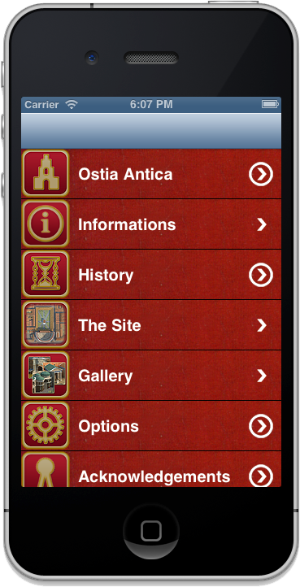
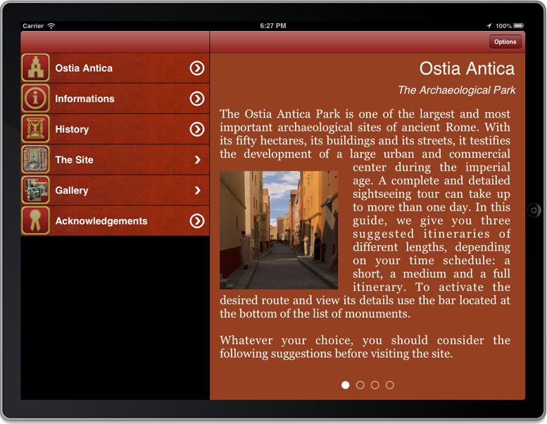
An Archaeological Guide for iOS devices
The main menu for iPhone and iPad.

Slide 3
Specifications
3 Languages: english, french and italian selectable within the App
4 layouts with different color scheme selectable withing the App
UINavigationViewController architecture for iPhone
UISplitViewController architecture for iPad
Core Data for content persistence
Content scrolls horizontally (like a book) rather than vertically (like a website).
Core Text for content custom rendering
Picture Gallery
Suggestion of three different itineraries
Monuments geolocalization
Custom Artwork
Zoom full screen for images
Rotation support

Slide 4
Specifications
The standard UISplitViewController offered by Apple makes it difficult to use a Full Screen feature because the rotation is not managed correctly (at least in iOS 4.3). I have therefore implemented a mimic of a UISplitViewController by modifying an existing project from Berhard Häussermann. This project implements a more versatile UISplitViewController where the rotation events are correctly delivered to all UIViewControllers of the application.
http://www.codeproject.com/Articles/307008/Versatile-programmer-friendly-split-view-controlle

Slide 5
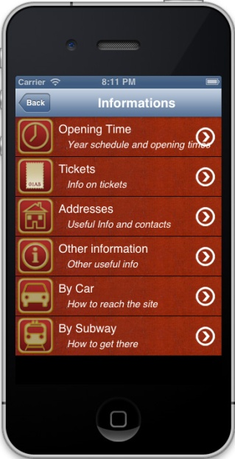
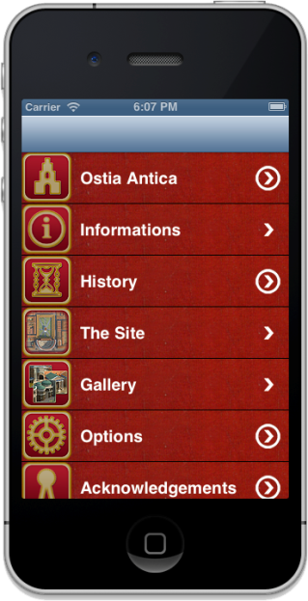
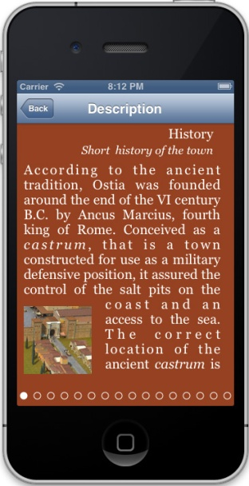
Application Architecture for iPhone
The Apps are device specific. For iPhone I have used a UINavigationController paradigm. When the user selects an item, a new View Controller is pushed on the stack. The user uses the back button to display the previous screen.

Slide 6
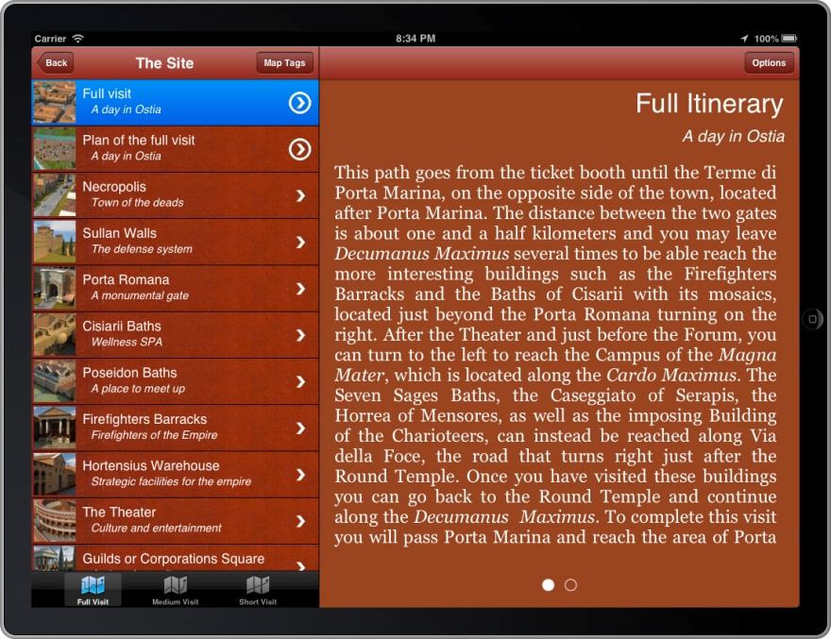
Application Architecture for iPad
The iPad uses a custom UISplitViewController paradigm. A Navigation Controllers to the left is used to display a list of hierarchical views and a Detail View Controller on the right is used to display the current selected item.

Slide 7
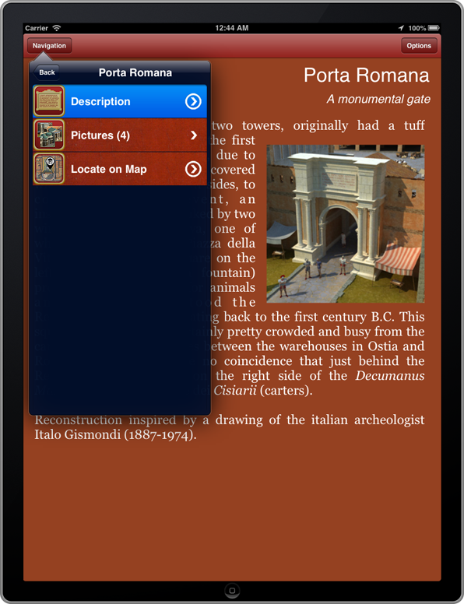
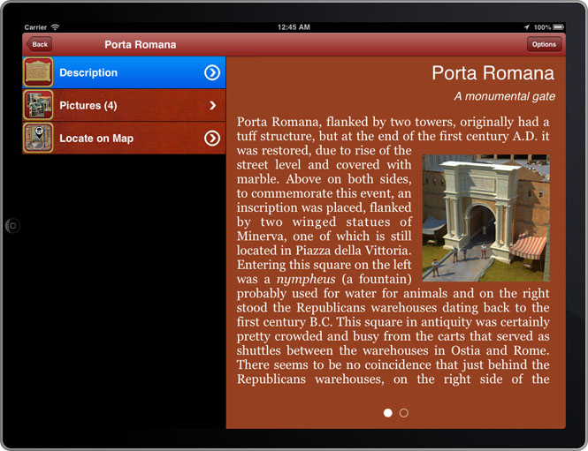
Application Architecture for iPad
The SplitView Controller displays the Navigation UIViewControllers on the left in Landscape, while it uses a popover to access the Navigation in Portrait mode.

Slide 8
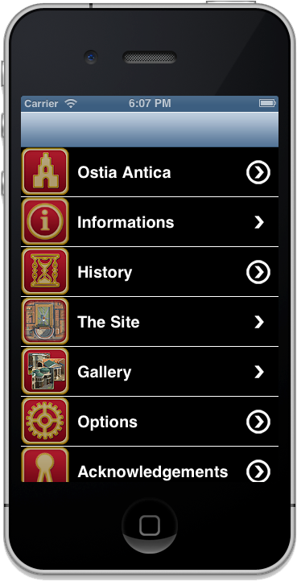
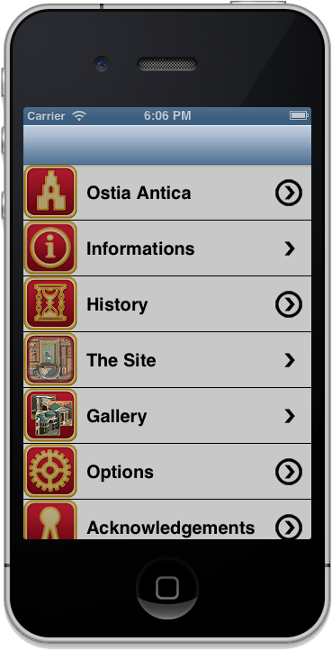
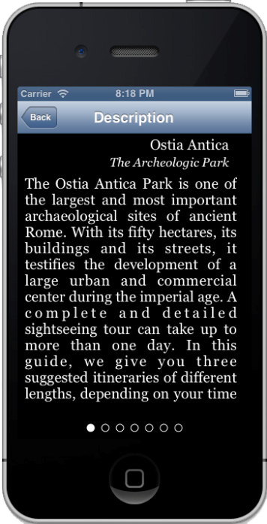
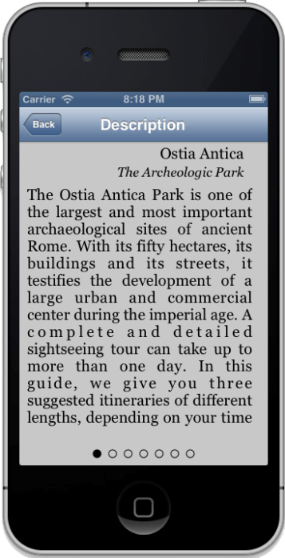
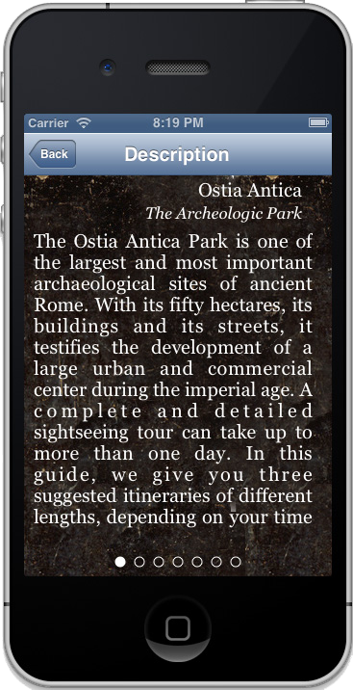
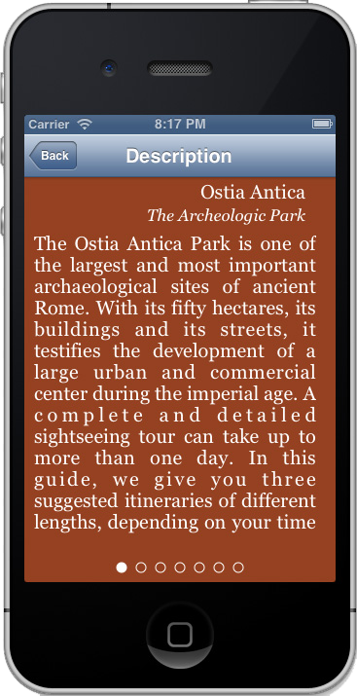
Layouts
The application offers 4 different layouts for a optimal contrast in darkness or strong lightning. The layouts can be switched directly from the interface.
Black Elegance
Modern Touch
Pompei Style
Roman Era

Slide 9
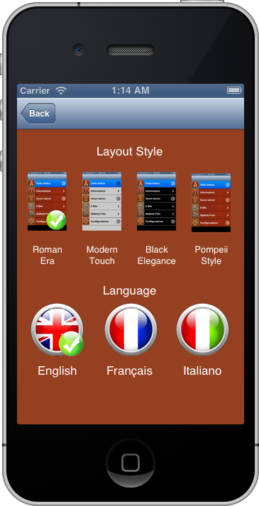
Languages
The application offers the possibility to switch instantly between English, French and Italian. The language switching impacts the contents as well every element of the application interface.

Slide 10
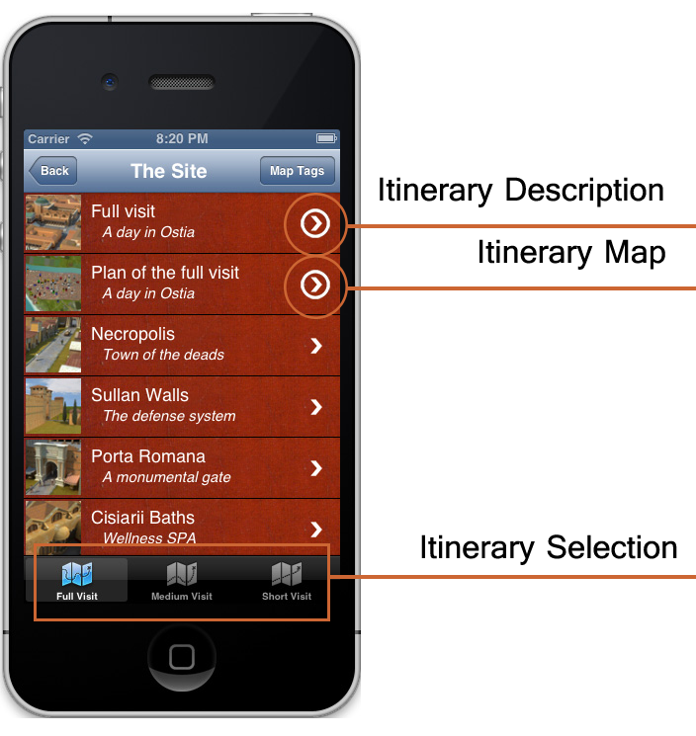
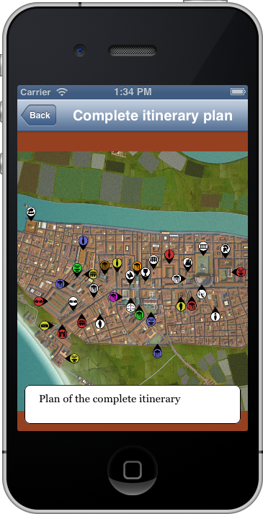
Itineraries
The TabBar at the botton of the Site view can be used to switch between three suggested itineraries. The first item of the list describes the itinerary, while the second item will show a map with the monuments that you select. It is possible to zoom the map for a better viewing.

Slide 11
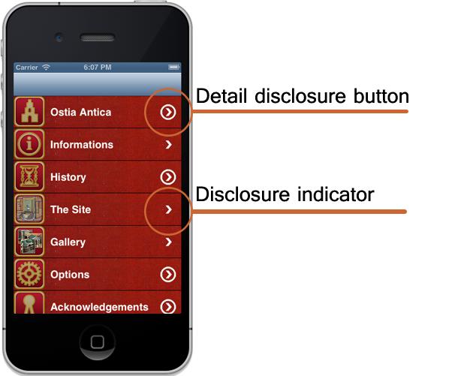
Navigation for iPhone
Disclosure indicator. When this element is present, users know they can tap anywhere in the row to see the next level in the hierarchy or the choices associated with the list item.
Detail disclosure button. Users tap this element to see detailed information about the list item.

Slide 12
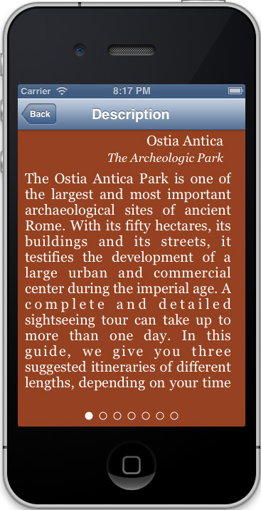
Menu Ostia Antica
It describes the Archaeological Park of Ostia Antica, the ancient harbour of Rome

Slide 13
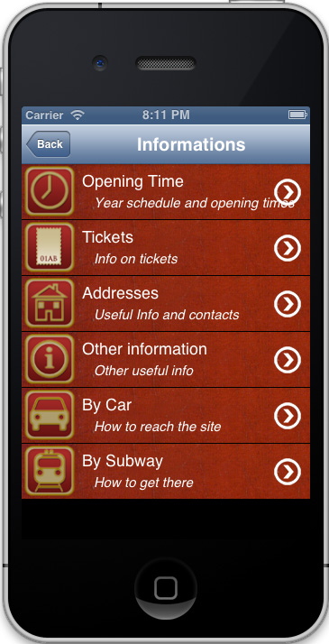
Menu Information
It gives access a submenu with useful information about the Archaeological Park

Slide 14

Menu History
It describes the history of Ostia, from the origins till IX century A.D.

Slide 15
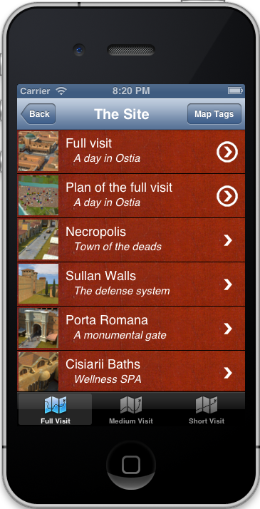
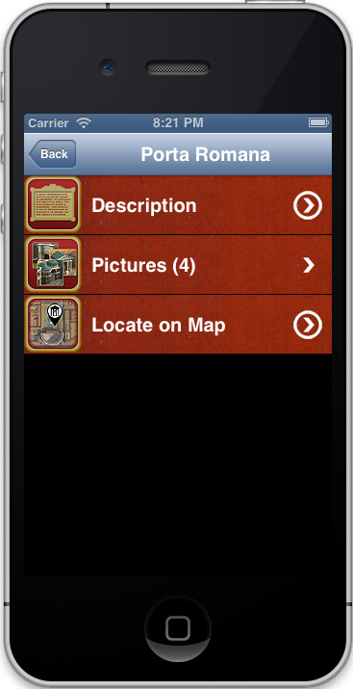
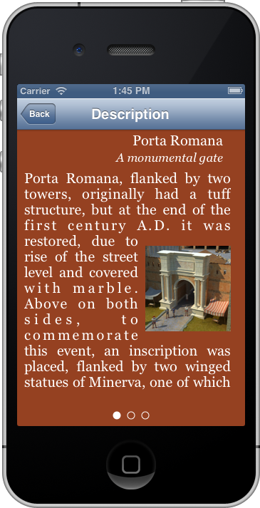
Menu ‘The Site’
It gives access to the description and images of the monuments of the site. It can be used also to select the monument based on the 3 itineraries. Each monument has 3 submenus to display text, images and geographic location.

Slide 16
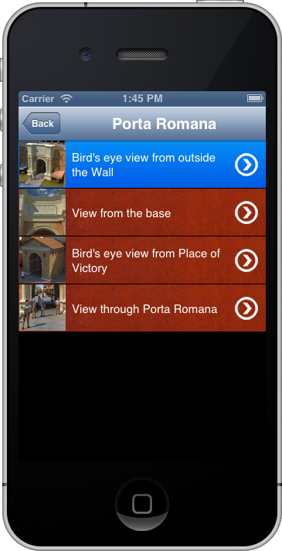
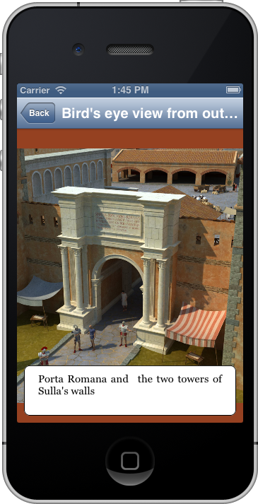
Menu ‘The Site’
The view Pictures lists all the Computer Graphics Reconstruction of the monument.

Slide 17
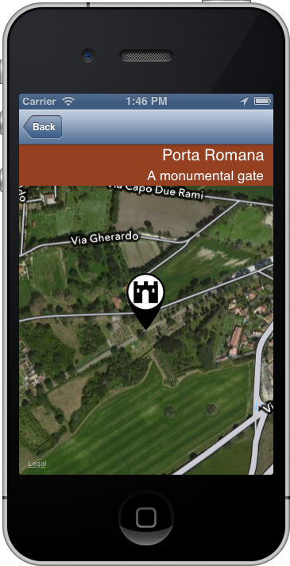
Menu ‘The Site’
Google map is used to display the geographic location of the monument of interest.

Slide 18
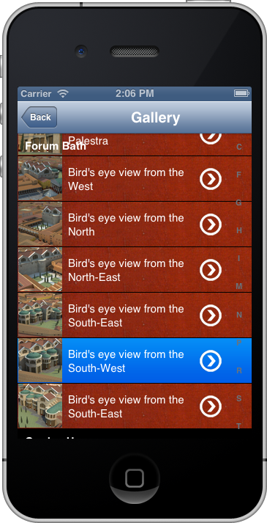
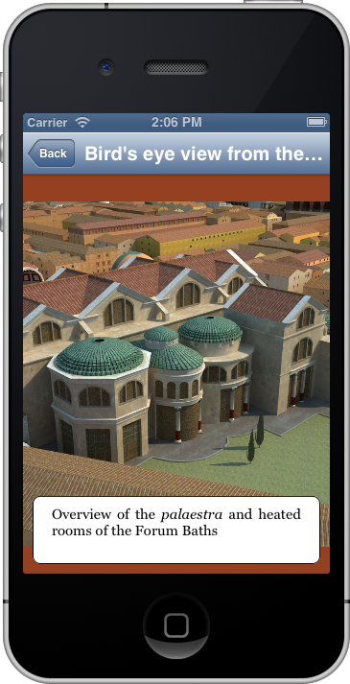
Menu Gallery
This view offers a categorized list of all Computer Graphic Reconstructions of the town of Ostia

Slide 19
Menu Options
It is used to select the layout type and the language of the application.

Slide 20
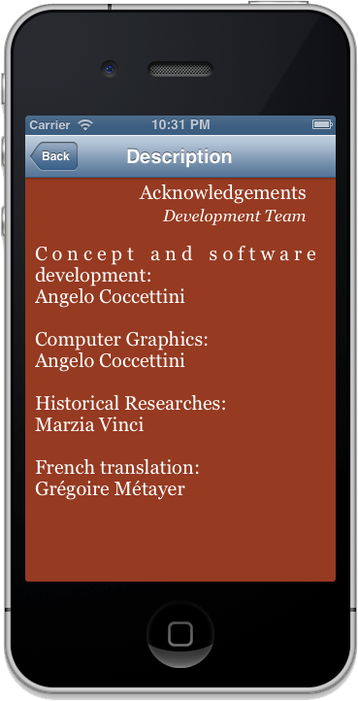
Menu Acknowledgements
Display info on the team that has worked for this version of the application

Slide 21
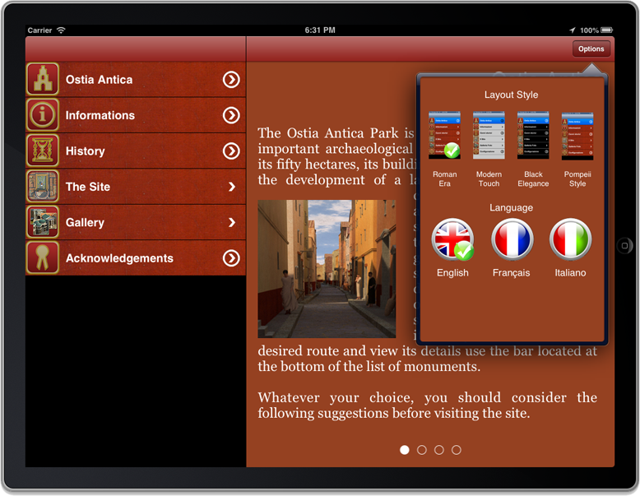
Navigation for iPad
The Navigation for iPad is basically the same as the one implemented on the iPhone. The difference is that the UINavigationControllers are displayed in the left hand window or in the popover when the application is in Portrait mode. The Option can be accessed through a popover in the Detail pane.

Slide 22
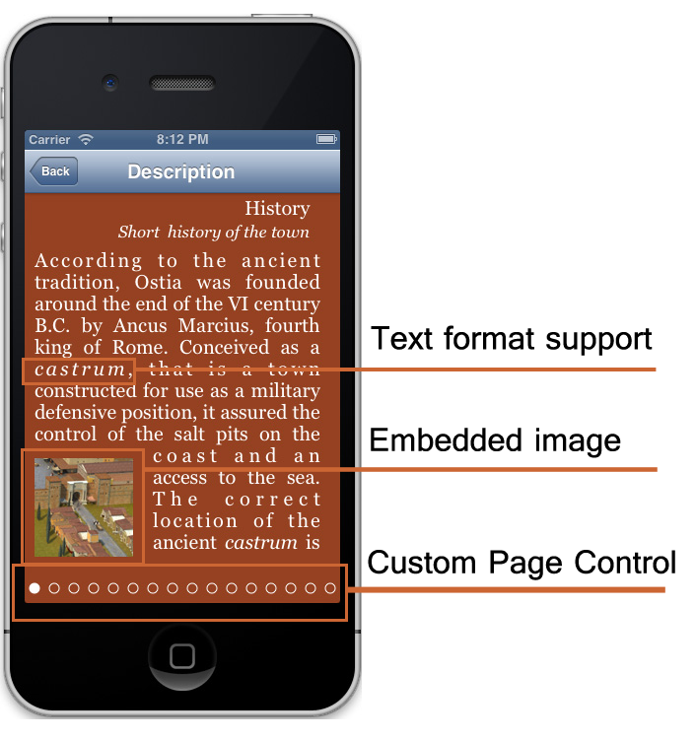
Core Text
The content is rendered using the Core Text framework that support a lite implementation of a HTML . The users can scroll the content horizontally, like the page of a book.
Embedded Images: the HTML lite support images embedded in text. The embedded images do support single tap event for full screen display mode.

Slide 23
Core Text
Supported Tags:
Tag | Comment
<b></b> | Bold
<i></i> | Italic
<u></u> | Underlined
<br> | Force carriage return.
<p></p> | Define a justified text paragraph.
<h1></h1> <h2></h2> <h3></h3> | Define Text Headers that use different font height (H1<H2<H3).
<center></center> | Center the text.

Slide 24
Core Text
Tag | Comment
<color [color tag]></color> | Test color. [color tag] := {red, green, blue, white, black}.
<size #num></size> | Modify the text size (used for example in the Core Text Label).
<img ‘fileName’ width=#w height=#h pos={l | r}> | Insert an image and resize its width and its height. The position could be left or right. If no width and height are specified, the system computes 2/5 of the width of the container UIView.
<link #linkName> | Insert an item link to #linkName. When the user tap on a link, the system pushes the corresponding item on the stack.
<popup #popupName> | Insert a popup link. A popup displays a Core Text popover in iPad and a message box in iPhone.

Slide 25
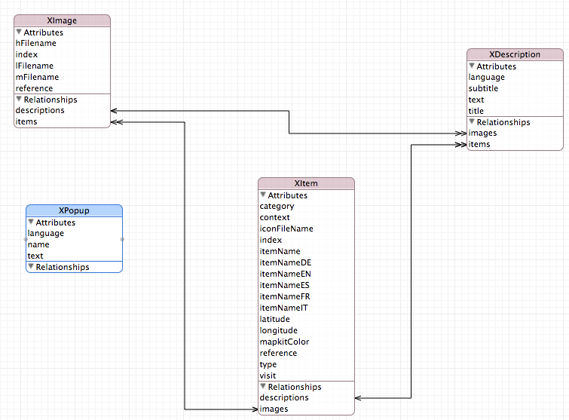
Core Data
The content persistence is managed by the Core Data framework. The system creates a Core Data persistence layer the very first time it runs on a device.

Slide 26
Options
The language selection is indipendent from the device settings. It is possible to switch between English, French and Italian at runtime. The content and the interface switch instantly.

Slide 27
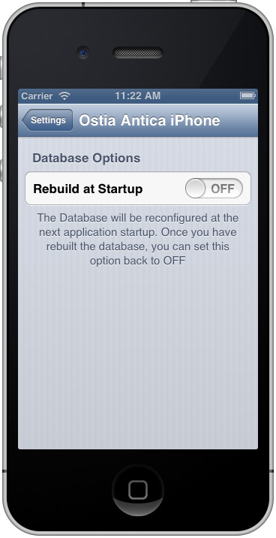
Special Options
When the user download the application, the system generates the Core Data persistence layer from the app bundle that contains the text files with the HTML-lite tags. If this database corrupts for any reason, it is possible to force the application to rebuild of the database with the activation of the Rebuild
at Startup in the application system settings. The user must shut down the app (remove from the background) and then run it again. At this poinz the application will remove the old database and it will rebuild it from scratch.

Slide 28










Artwork
I have produces all the Artwork of the application. Here some example of artwork for both applications.
Map tags
Map Pins

Slide 29















Artwork
Interface

Slide 30
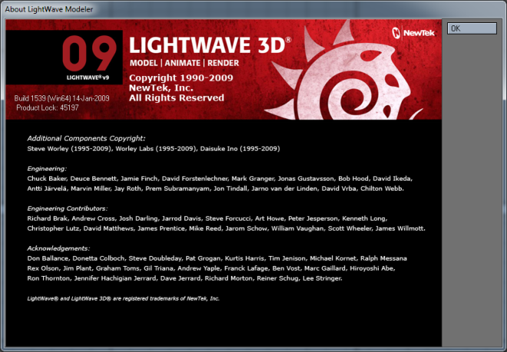

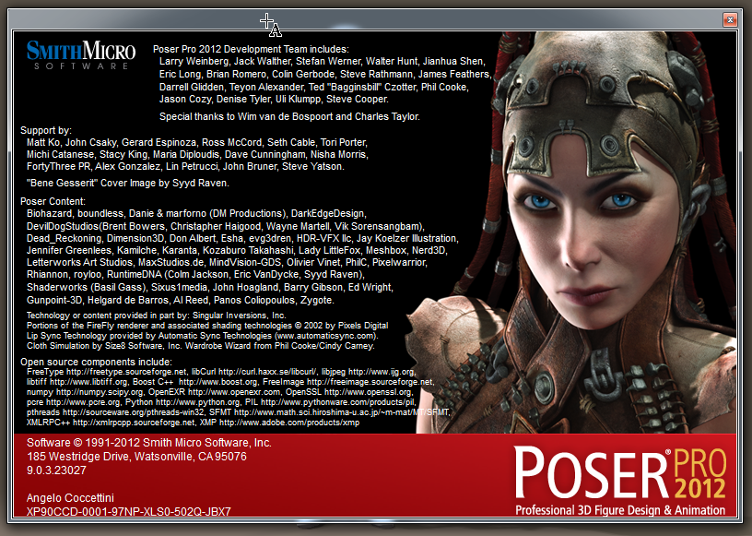
Computer Reconstructions
I have reconstructed the whole town with Computer Graphics software:
LightWave from Newtek
CityEngine from ESRI
Poser from SmithMicro

Slide 31
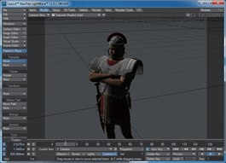
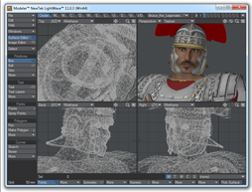
Workflow
Layout
Modeler
HUB
PoserFusion
Export Wavefront
OBJ, MTL

Slide 32
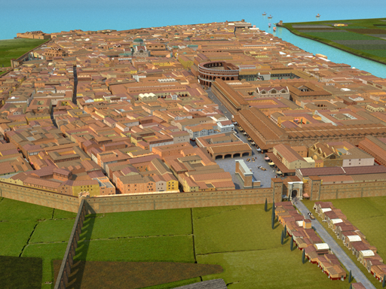
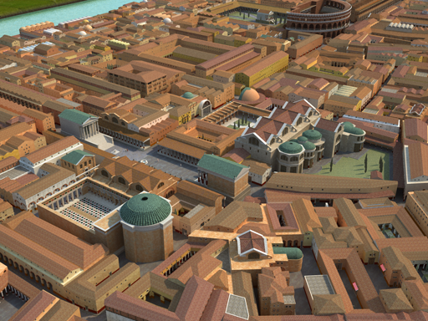
Reconstructions
I have modeled the whole town with a uniform level of details. This mean that it is possible to move the digital camera in any place and to produce high detailed images. The polygon count of the whole scene (building, actors, props and stage) is around 15.000.000 of polygons.

Slide 33



Apple Store
The Apps are published and available on the Apple Store

Slide 34
Contacts
The Apps are published and available on the Apple Store

