Slide 1


Slide 2
What is this presentation about?
Computer Graphic reconstruction of the roman town of Ostia, colony of Rome.
Methodology & Techniques
Software

Slide 3
Why Ostia?
An exhibition of Ostia Antica was held in Geneva from 23 February to 22 July 2001.
I have developed the interactive workstation with Touch Screen and produced the first GC images of Ostia.

Slide 4
Where is Ostia?
Ostia is the harbour of the ancient Rome.
It is the third archeological site in Italy for importance and extension after Pompeii and Rome. It is one of the most extended archeological site world-wide.

Slide 5
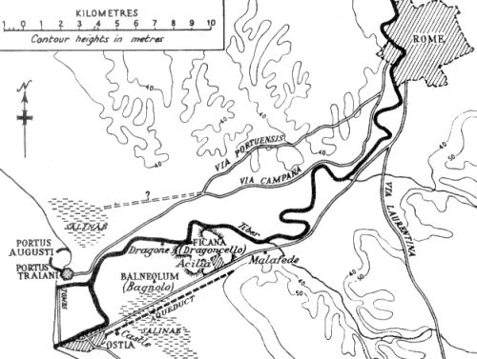

Slide 6
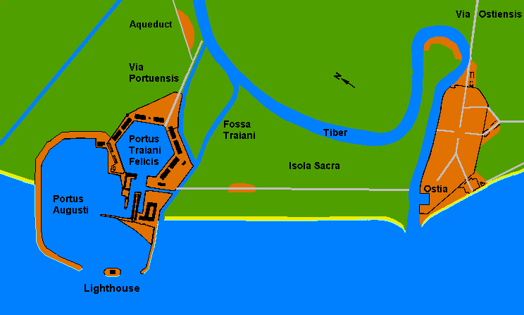
Ostia
Portus

Slide 7
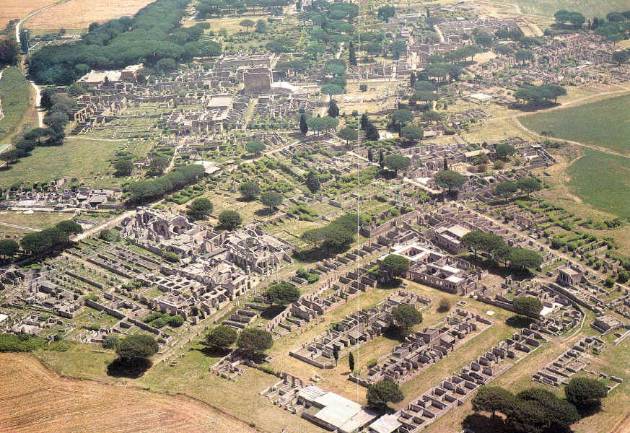
Ostia Today

Slide 8
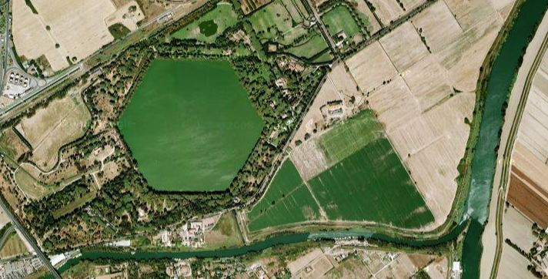
Trajan’s harbour
still visible today

Slide 9
About Ostia
Ostia has been founded on IV century B.C. and it has been abandoned on IX century A.D.
Ostia (together with Portus) is the most important harbour of the whole antiquity
Surface of the town is evaluated to about 50 hectares, part of which has not been escavated yet.
Ostia reached a max of 80.000 / 100.000 inhabitants at its apogee.

Slide 10
Let’s start the 3D Journey!

Slide 11
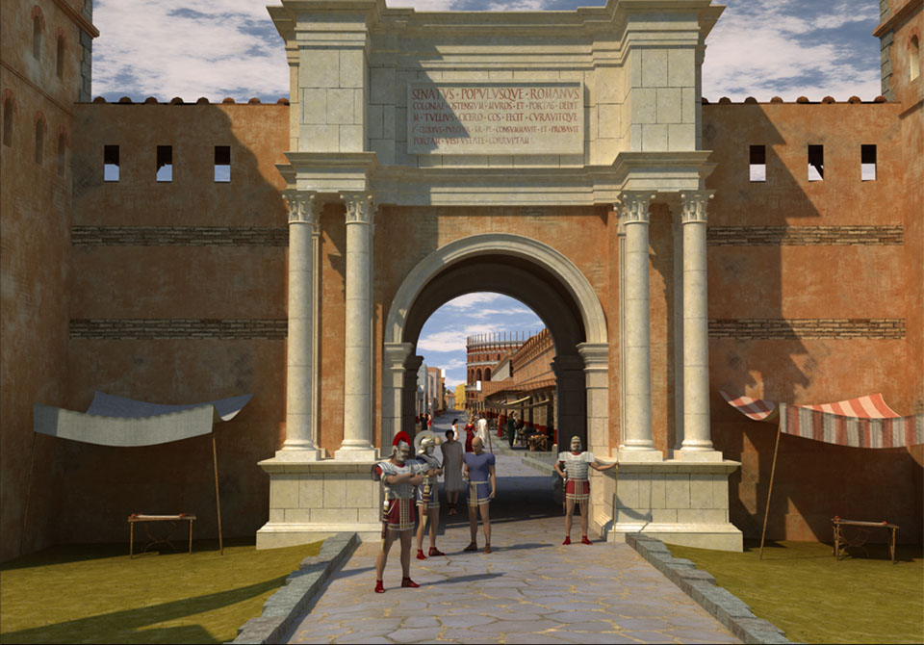
Porta Romana

Slide 12
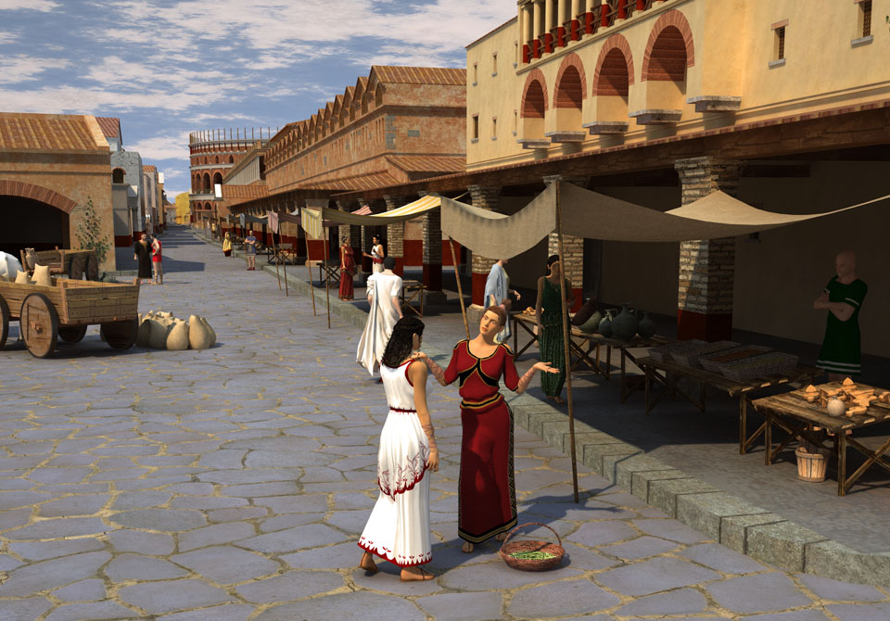
Place of the Victory

Slide 13
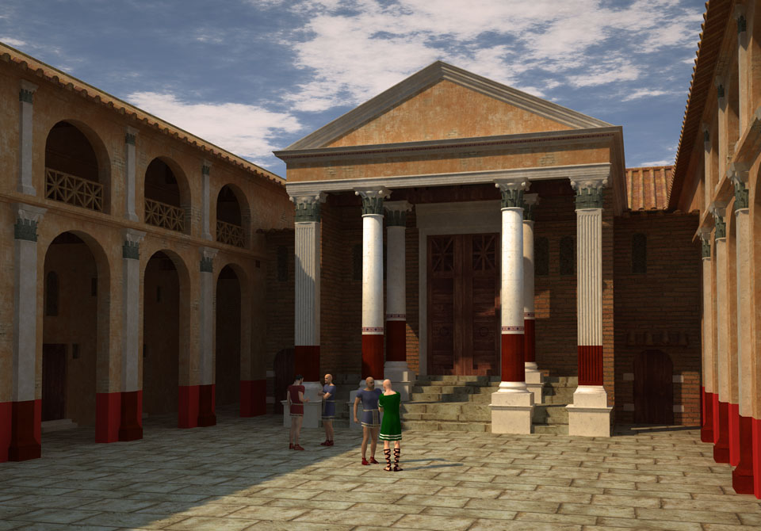
Barracks of Vigiles

Slide 14
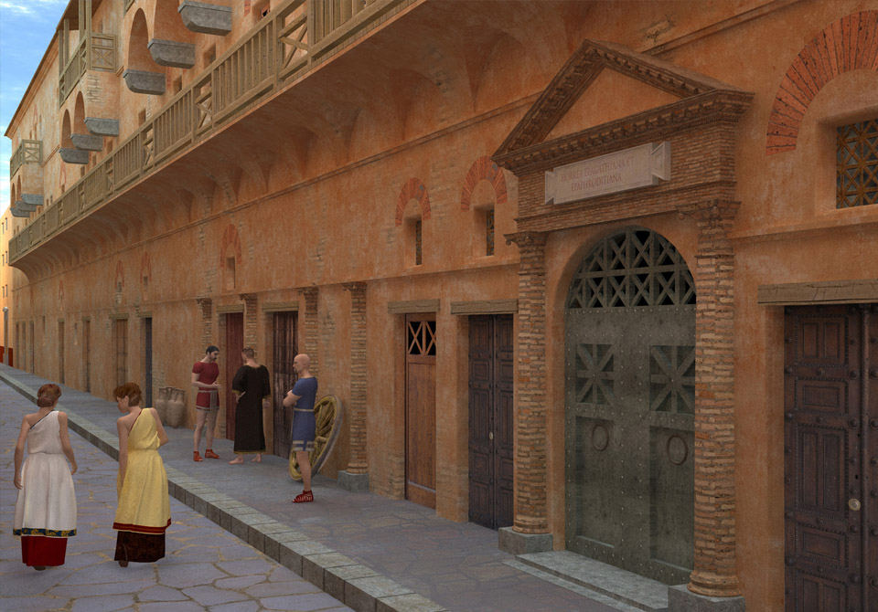
Horrea Epagathiana

Slide 15
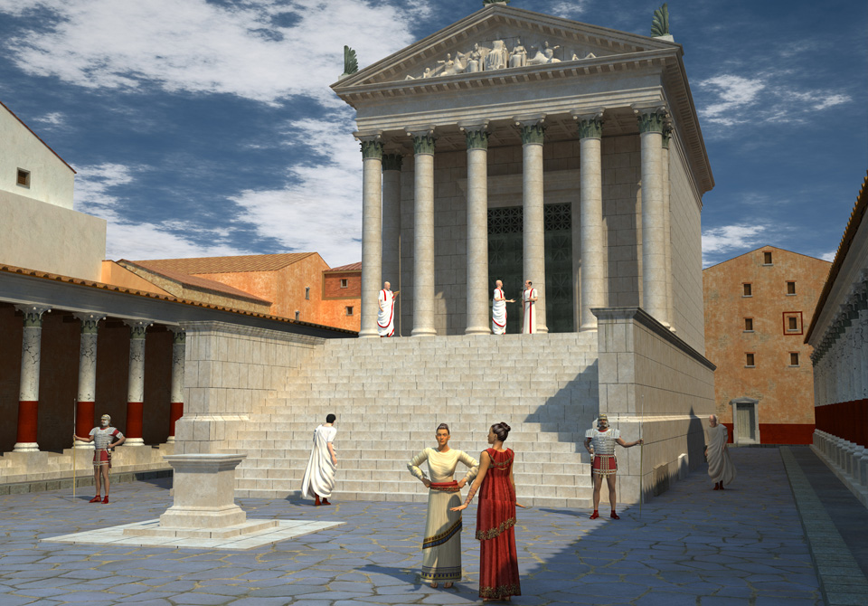
Capitolium

Slide 16
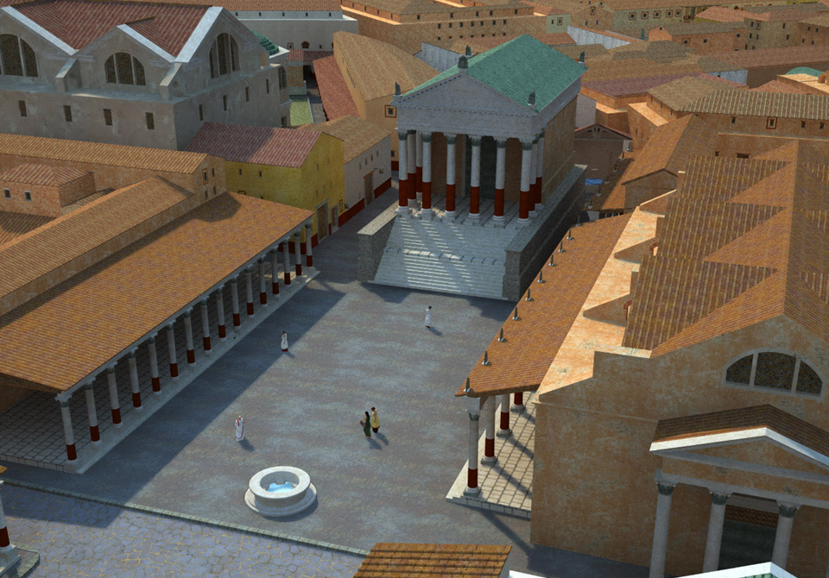
Forum

Slide 17
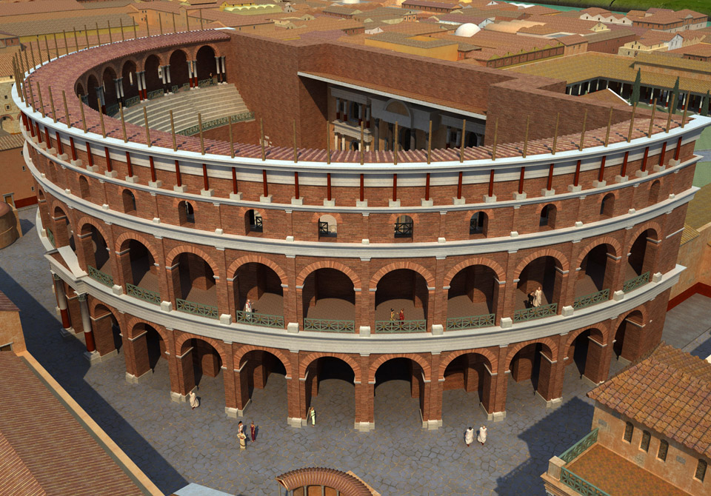
The Theater

Slide 18
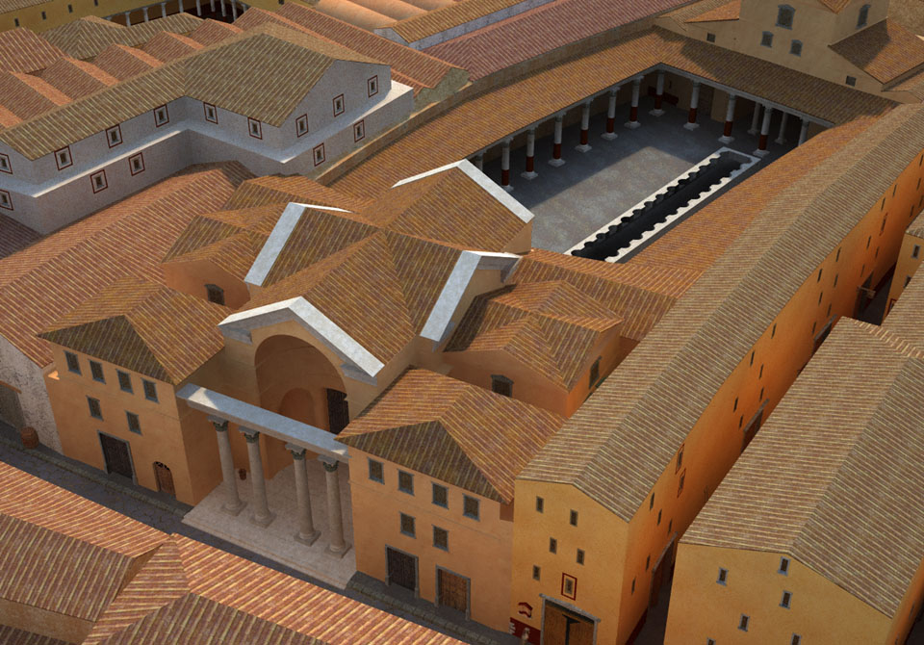
Schola of Trajan

Slide 19
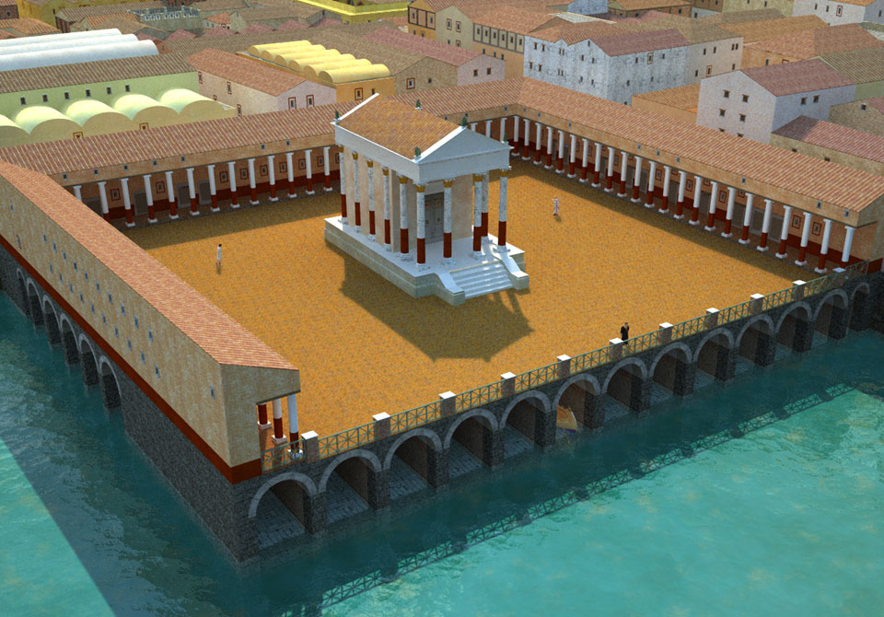
Navalia

Slide 20
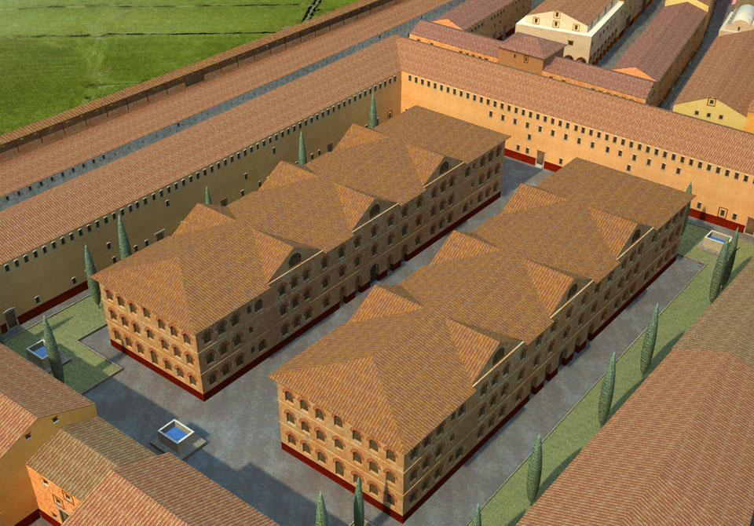
House Garden

Slide 21
The Making Of

Slide 22
Documents and info
Map and plan
Drawing and photos
Other reconstructions
Library researches
Onsite recognition

Slide 23
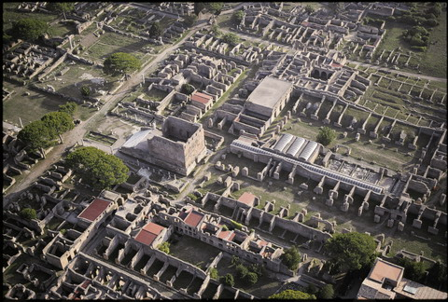
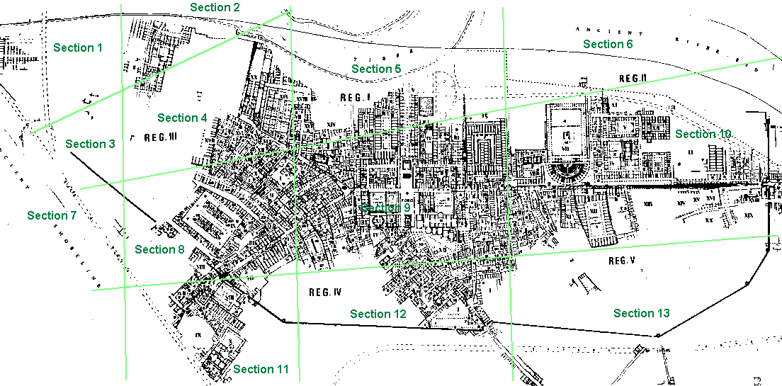

Slide 24
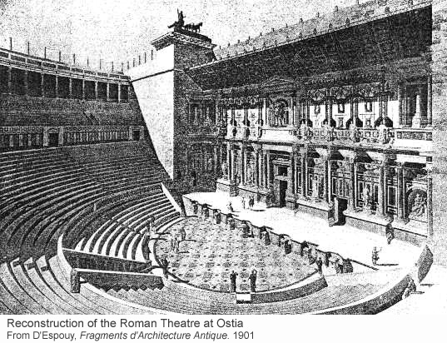
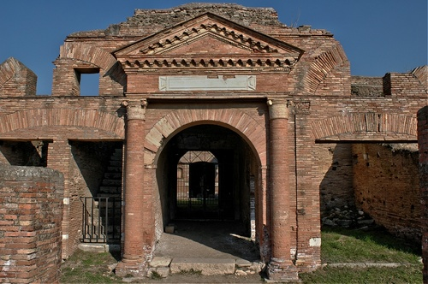

Slide 25
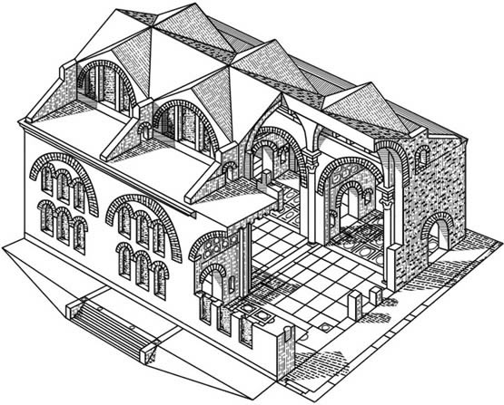
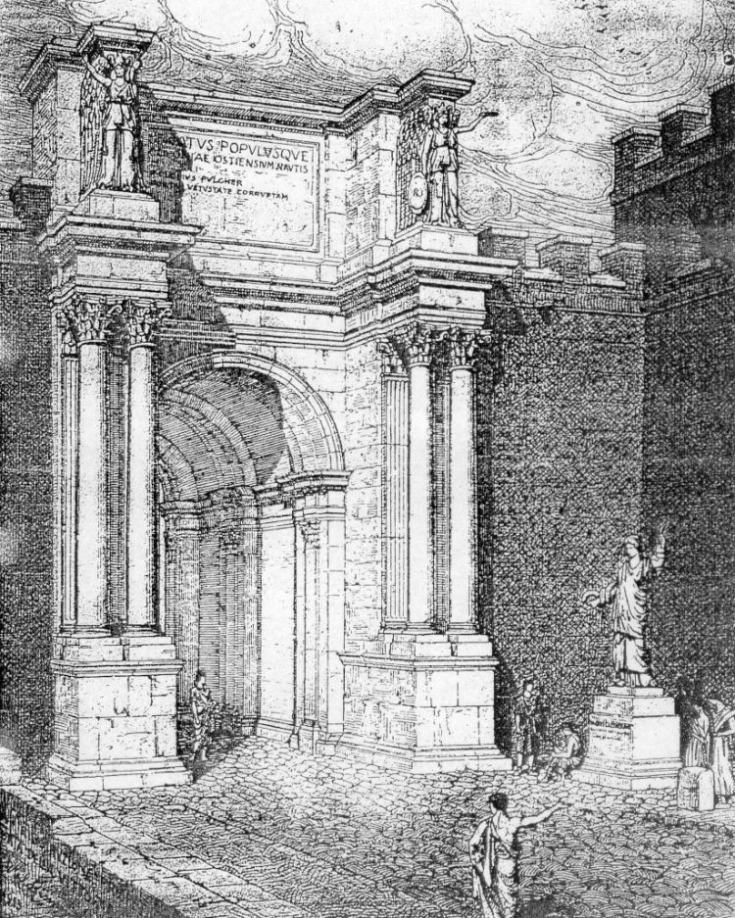
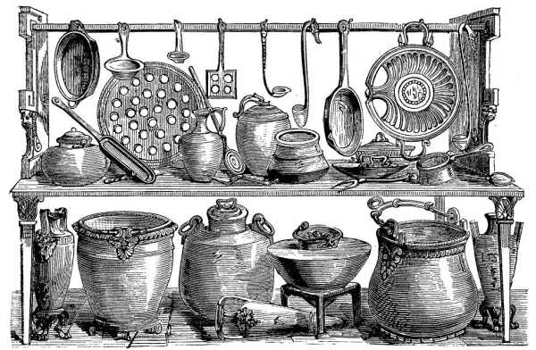

Slide 26
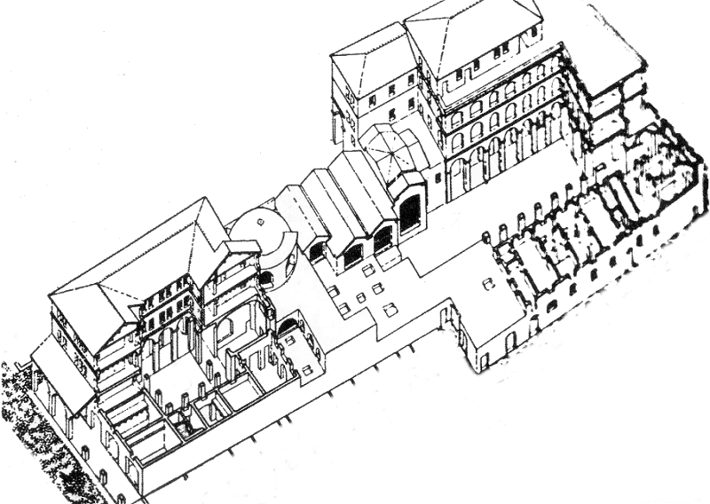
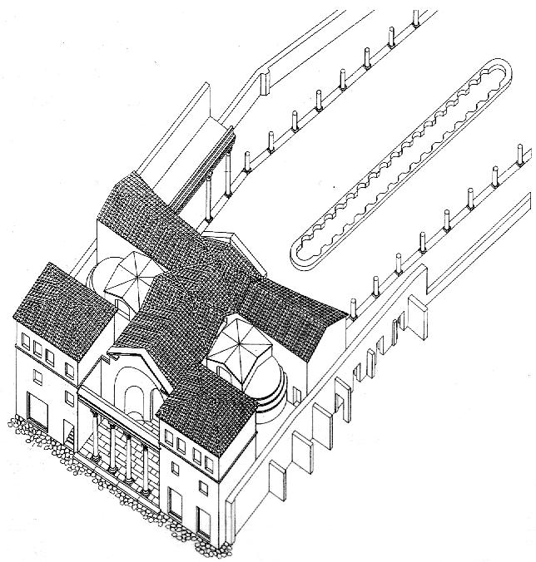
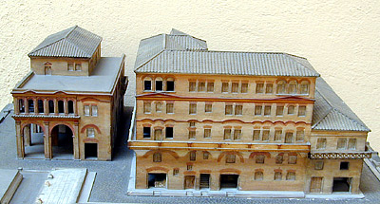
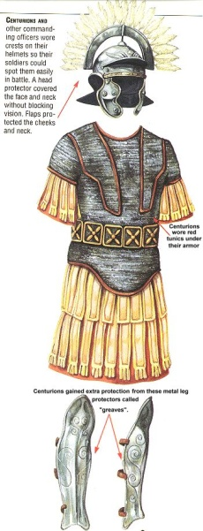
Caseggiato del Serapide
Schola del Traiano
Casa di Diana

Slide 27
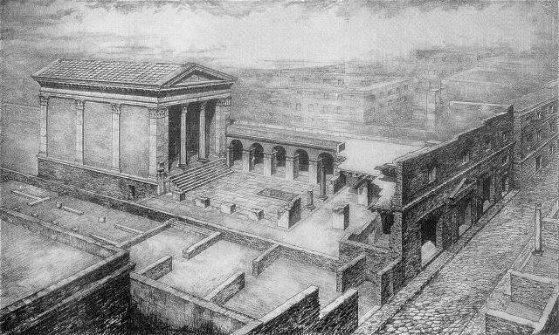
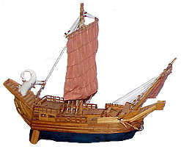
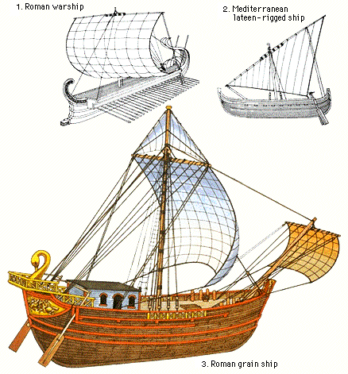
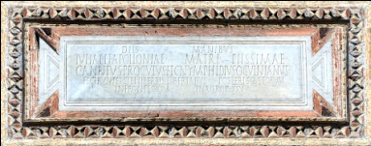
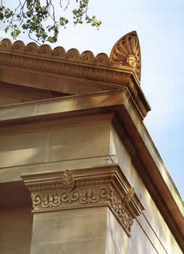
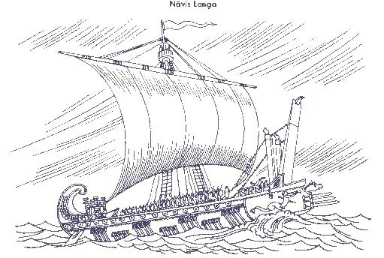
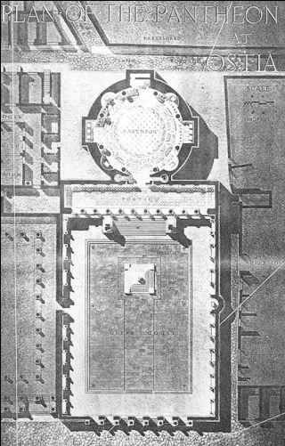
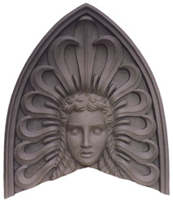
Fabri Navales

Slide 28
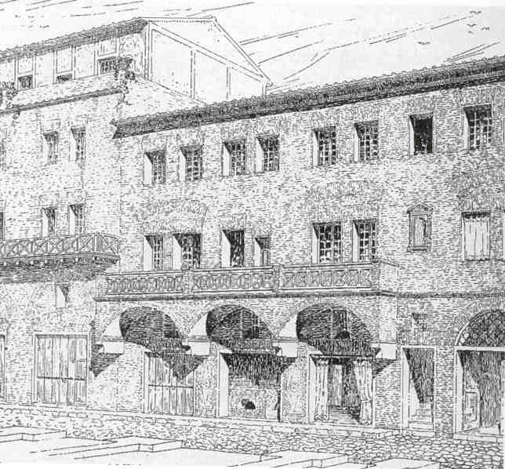
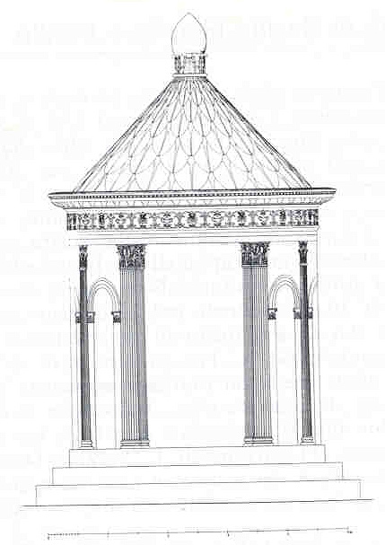
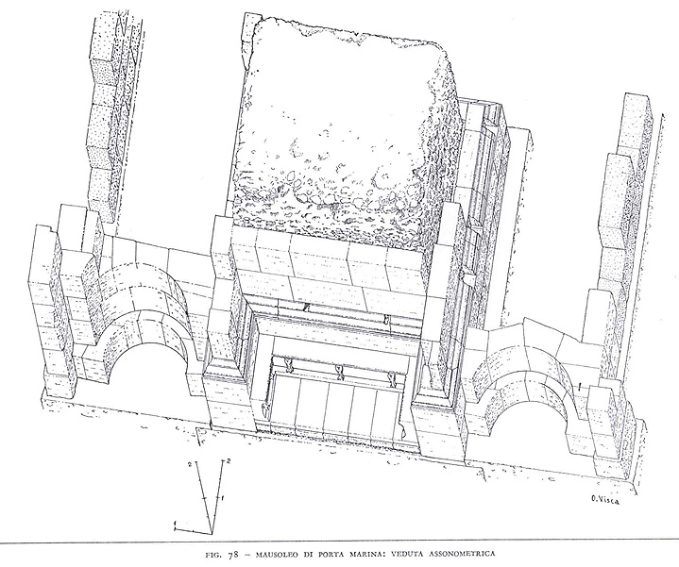
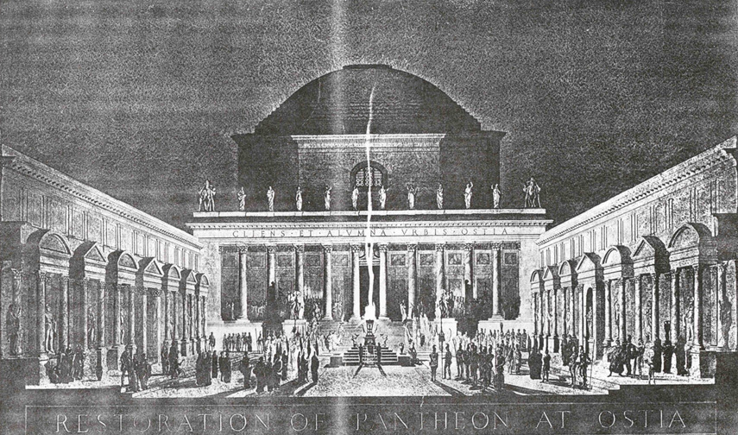
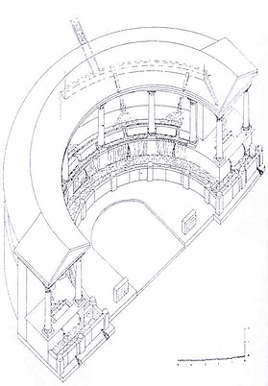

Slide 29
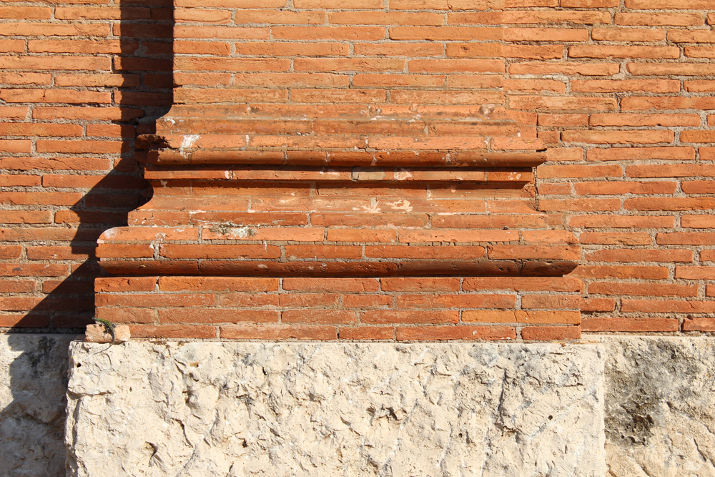
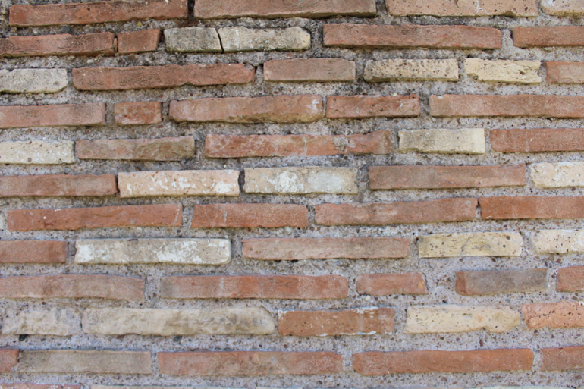
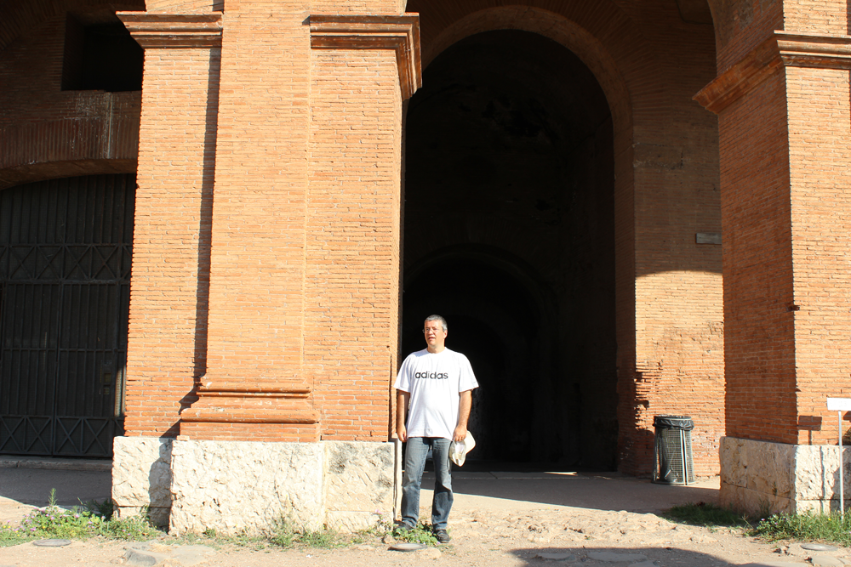
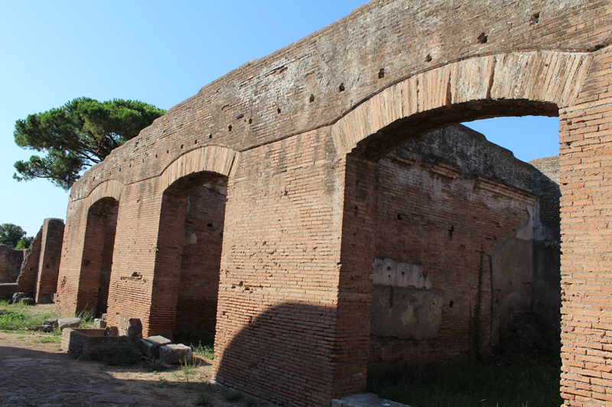

Slide 30
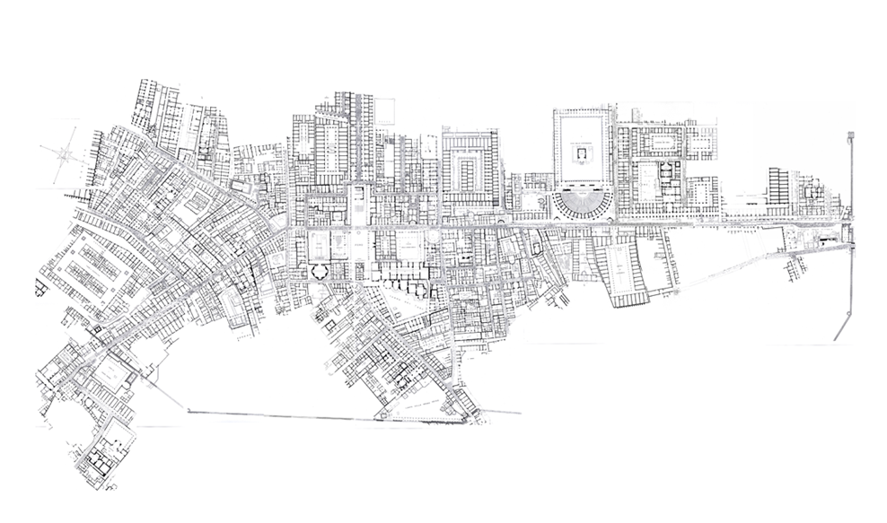
The Archeological Map

Slide 31
CG Software
LightWave from Newtek
CityEngine from ESRI
Poser from SmithMicro

Slide 32
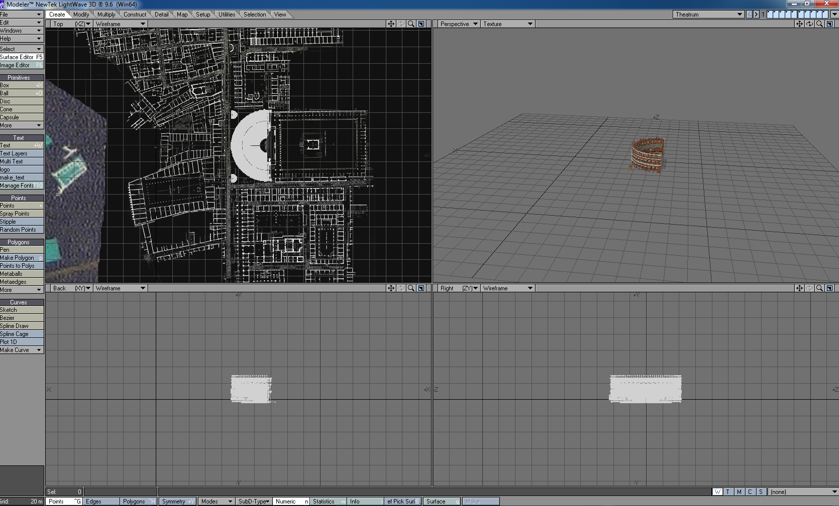
Lightwave from Newtek

Slide 33
Lightwave
Its my central 3d and rendering software. I load into LW all objects created with the other two applications.
Lightwave is devided into two independent applications: Modeler and Layout
  Modeler: used to create meshes and to texture them
  Layout: it is used to put the objects into a stage and to produce the renderings.

Slide 34
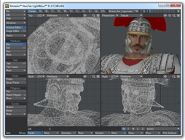
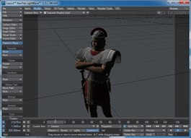
LightWave
HUB

Slide 35
CG Concepts
Meshes (points, polygons, normals)
Textures (images map, procedurals, gradient)
Texture Projection (cubic, planar, UV)
Mesh Modeling (boolean, splines, cages,..)
Layers
Surfaces (Luminosity, Diffuse, Transparency,..)
Shaders (Frenel, Thin Film, Noises,..)
Lights (Area, Distant, Dome,..)

Slide 36
CG Concepts
Shadows (Ray Trace, Shadow map)
Radiosity (Monte Carlo, Backdrop)
Scripting (plugin, LWScript)

Slide 37
CG Techniques
Sun Light Modeling
Dome light for diffuse light
Radiosity
Seamless Textures (creation and editing)
UV Mapping
Polygon Crunching
Export from CityEngine
Export from Poser (Plugin)
Backdrop alignments
Clouds with Procedural Textures

Slide 38
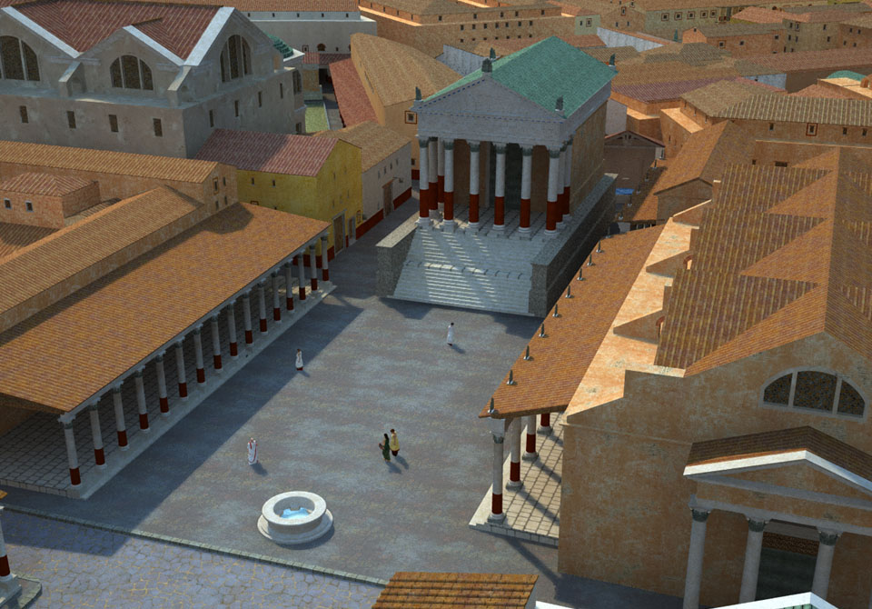

Slide 39
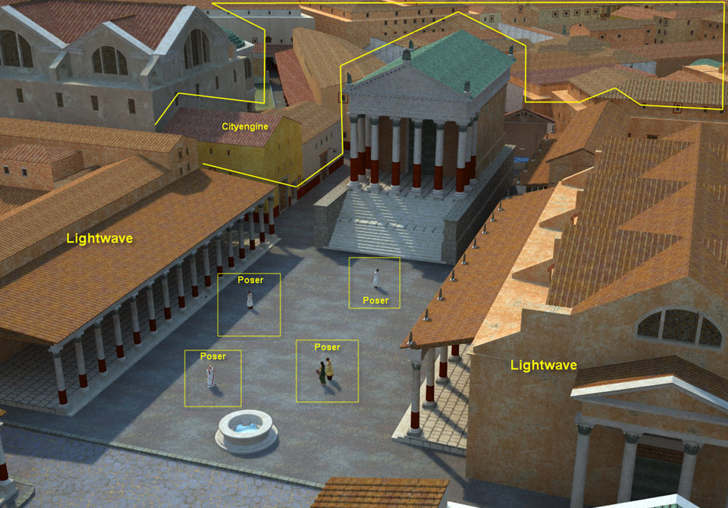

Slide 40
Buildings
Generic buildings (houses, horreas, domus)
Unique monuments (Porta Romana, Theather, Capitolium, Basilica, Thermae of the Forum, ..)

Slide 41
How to model a typical building
To model a building of any type can be resumed in a sequence of actions with defined effect.

Slide 42
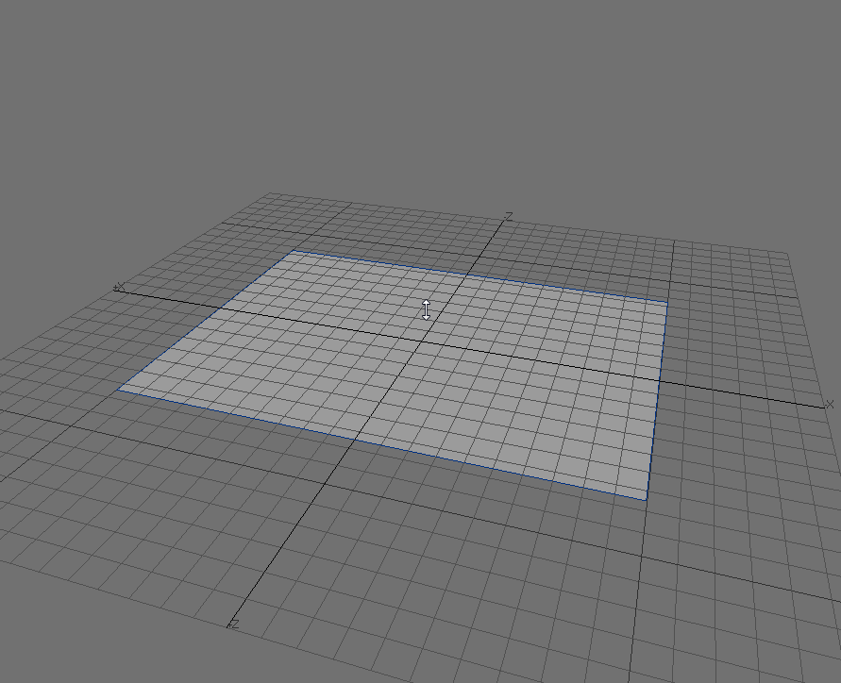
Draw the Base

Slide 43
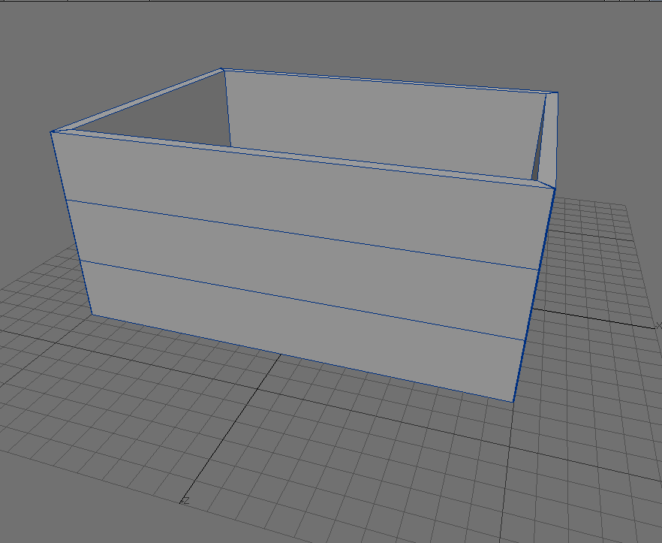
Extrude the Building

Slide 44

Draw Details

Slide 45

Perform Solid Boolean

Slide 46

Build the Roof

Slide 47

Texture and Colors

Slide 48
Algorithm
Build the Base
Extrude
Add Details
Build Roof
Define Texture and Colors
Save Object

Slide 49

Mesh Approach

Slide 50
Drawbacks
Time consuming
Repetitive
Low variance (all buildings look the same)
Low flexibility (if error, the whole building must be rebuilt from scratch)

Slide 51

Procedural Approach

Slide 52
Algorithm
Square
Extrude 10 // build wall with height 10 m
Split (y, 3) // Create 3 the floor
Insert(‘’Window.obj’’ ) //Create the windows
Insert(‘Door.obj’’ ) //Insert Doors
InsertRoof(‘’gable’’) //Create Roof
PaintWall(‘’Wall 1’’) //Color the wall

Slide 53
Grammar
Building One
A: 13
B:4
OBJECT: Door2.obj
ROOFTYPE: Hip
TEXTURE: Wall2
Square
Extrude A
Split (y, B)
Insert(OBJECT )
InsertRoof(ROOFTYPE)
PaintWall(TEXTURE)
Building Two
A: 10
B:3
OBJECT: Door1.obj
ROOFTYPE: Gable
TEXTURE: Wall1

Slide 54

Models loaded on CityEngine

Slide 55
Cityengine Workflow
Export
Wavefront
OBJ, MTL

Slide 56
Actors

Slide 59

Poser

Slide 60
PoserFusion
It is possible to create a mesh in Poser and to export natively in Lightwave (animation included)
Lightwave can now open file in PZ3 format.

Slide 61





Some Personnages

Slide 62





Some Personnages

Slide 63
Complete Workflow
Layout
Modeler
HUB
Export
Wavefront
OBJ, MTL
PoserFusion

Slide 64

Global View

